Slide 1
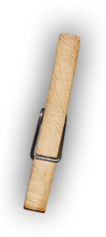
Skill Builders
Mixed Media Painting
Image Transfer
Pam Ehrenreich pehrenreich@bcps.org mrsestudio48.weebly.com @MrsE_Studio48

Slide 2
Skill Builder Day 1

Slide 3
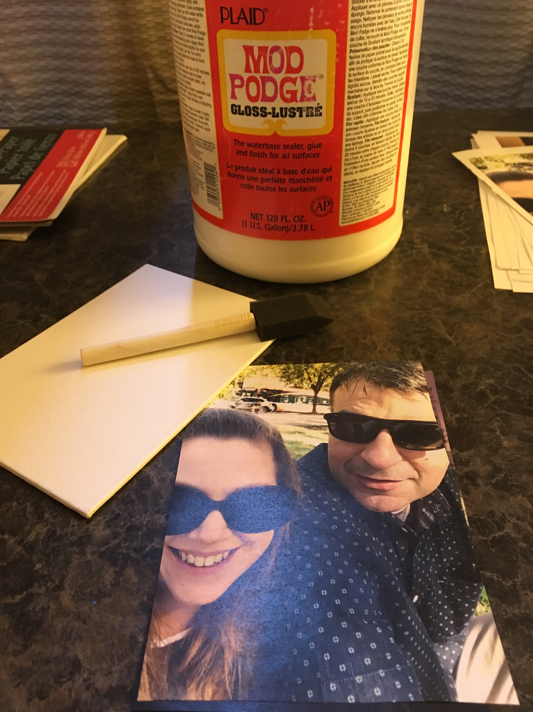
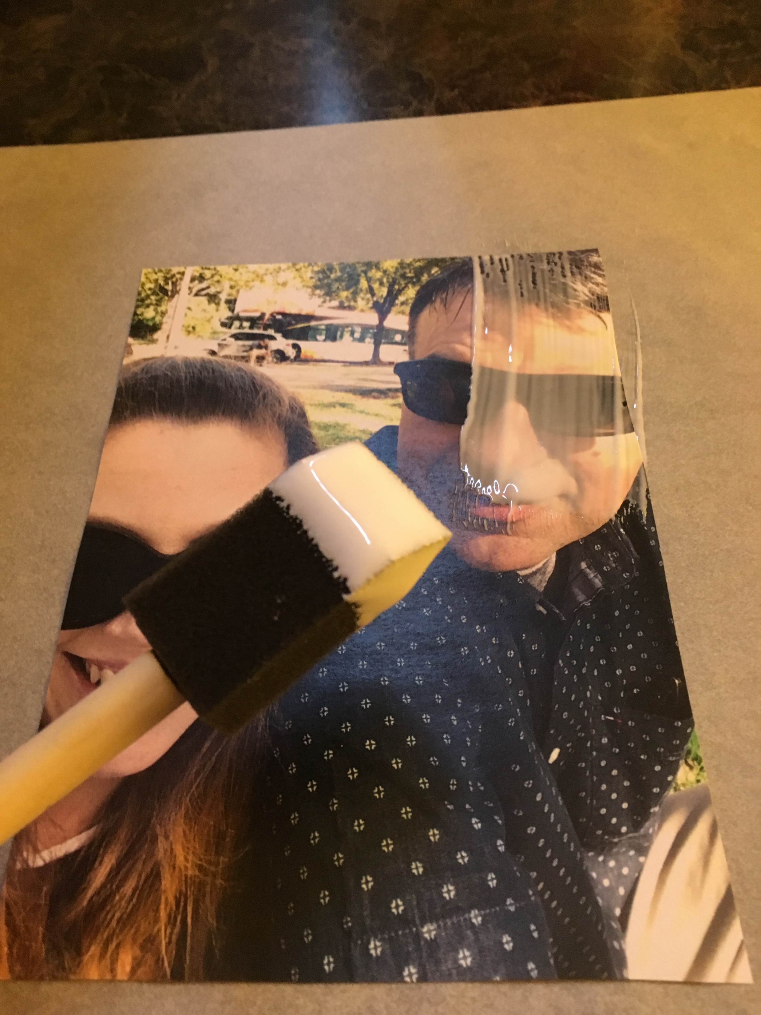
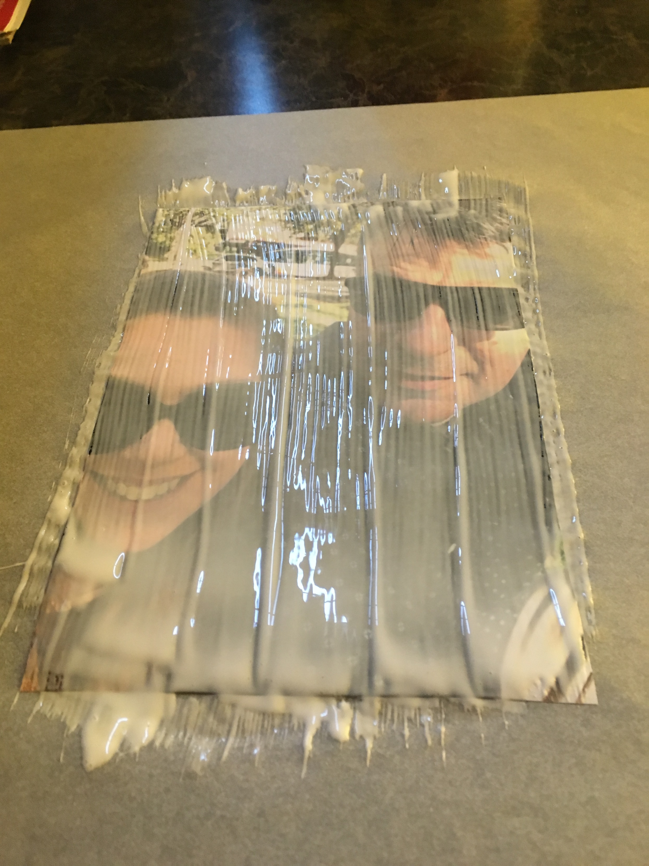
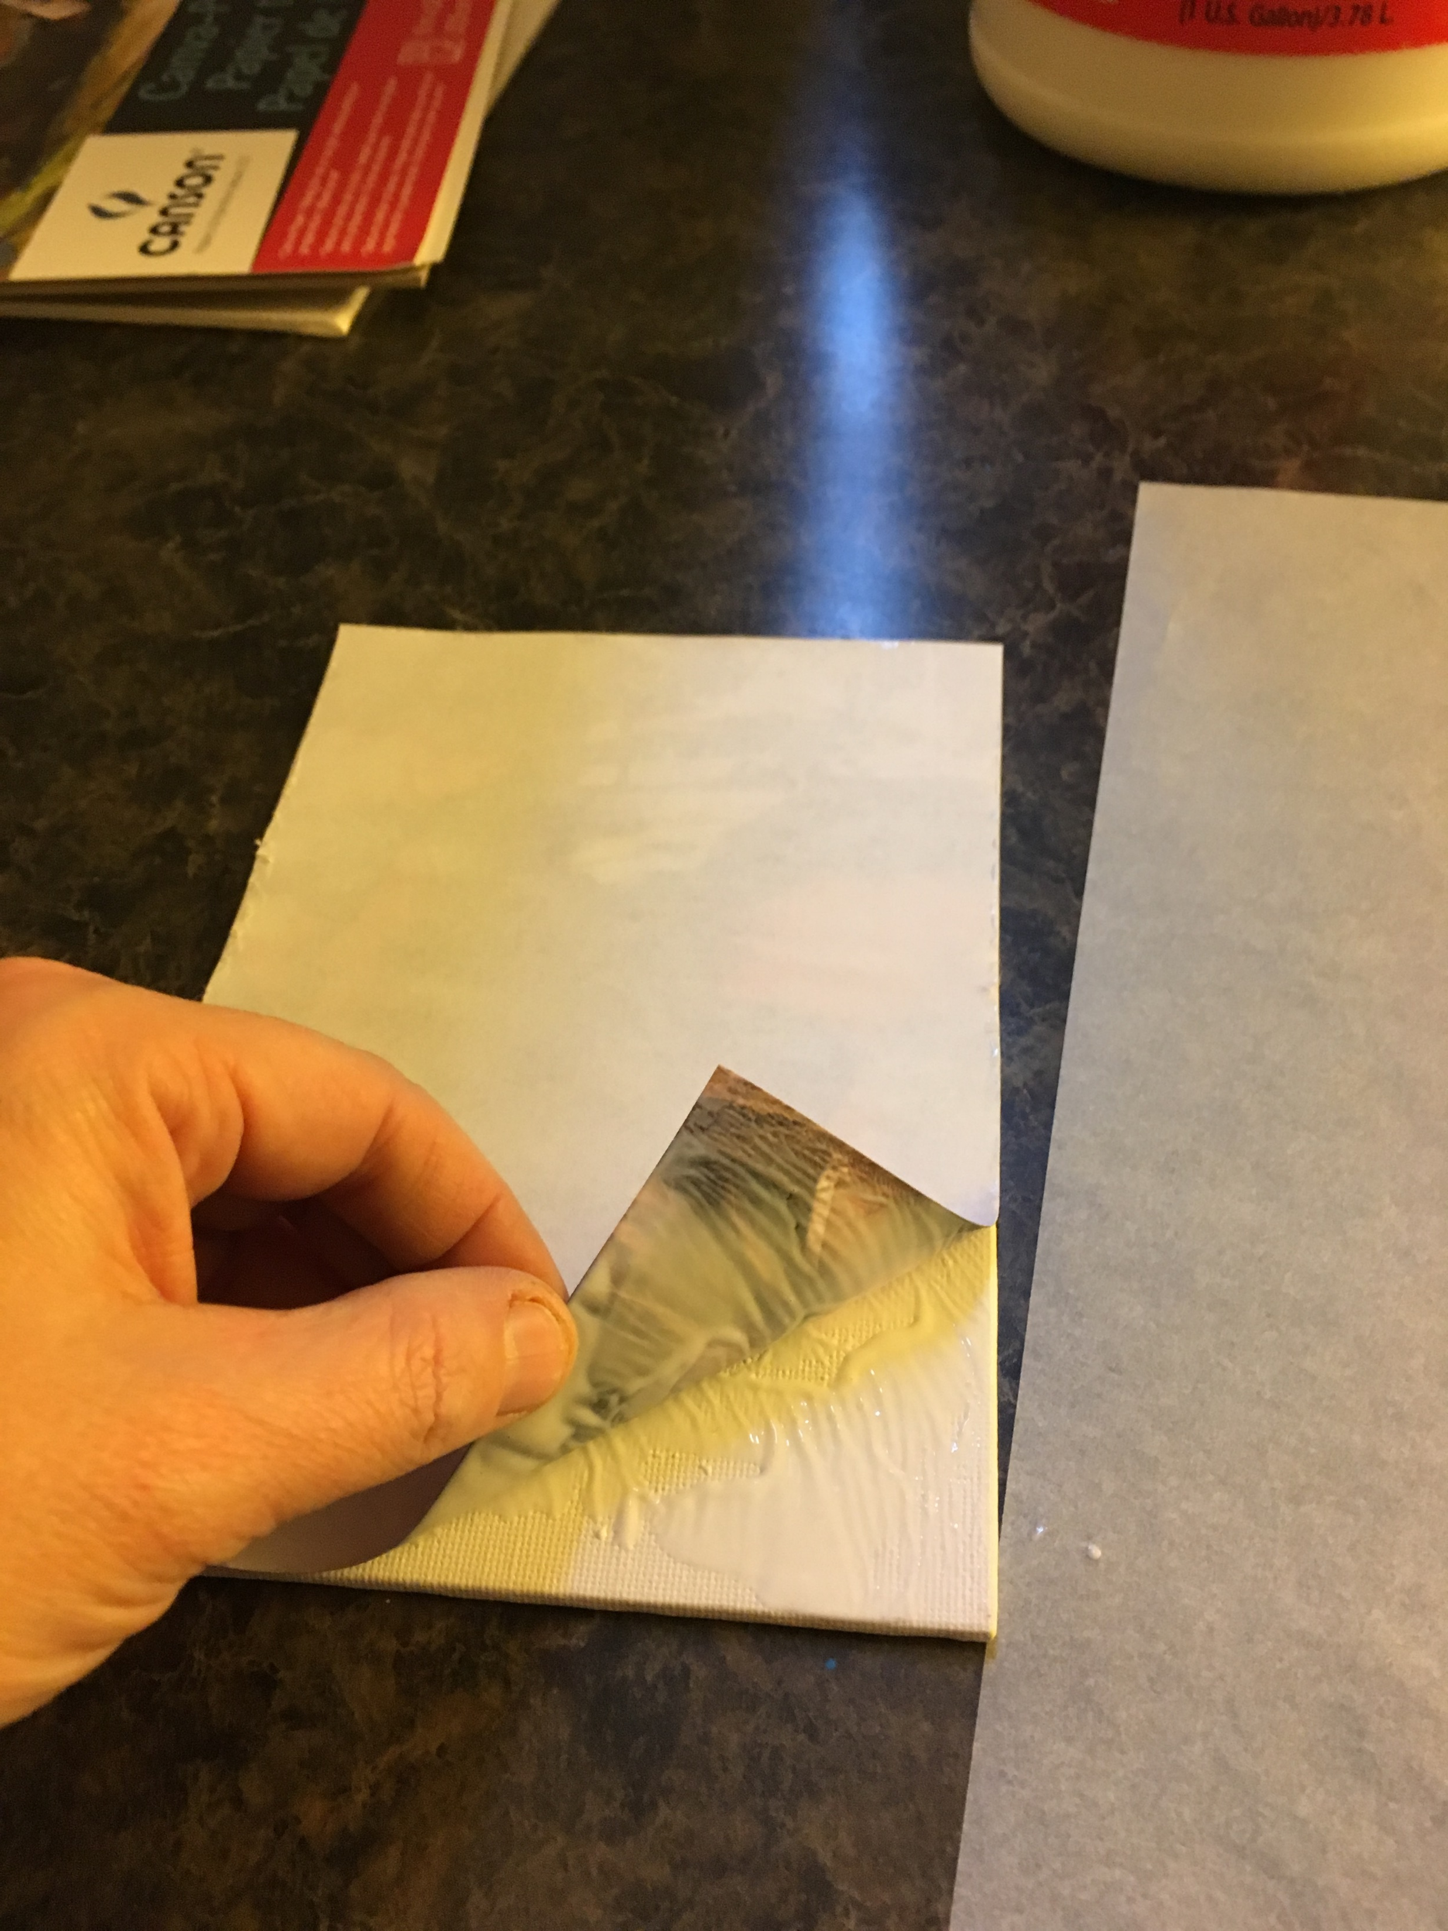
Image Transfer Day 1
Directions:
Coat image with mod podge
Place face down on canvas paper or board
Gently smooth with ruler or your fingers
Set aside to dry until next class or use hairdryer
You will need:
An image from the printer
Mod Podge
Foam Brush
Canvas paper or board
Ruler

Slide 4
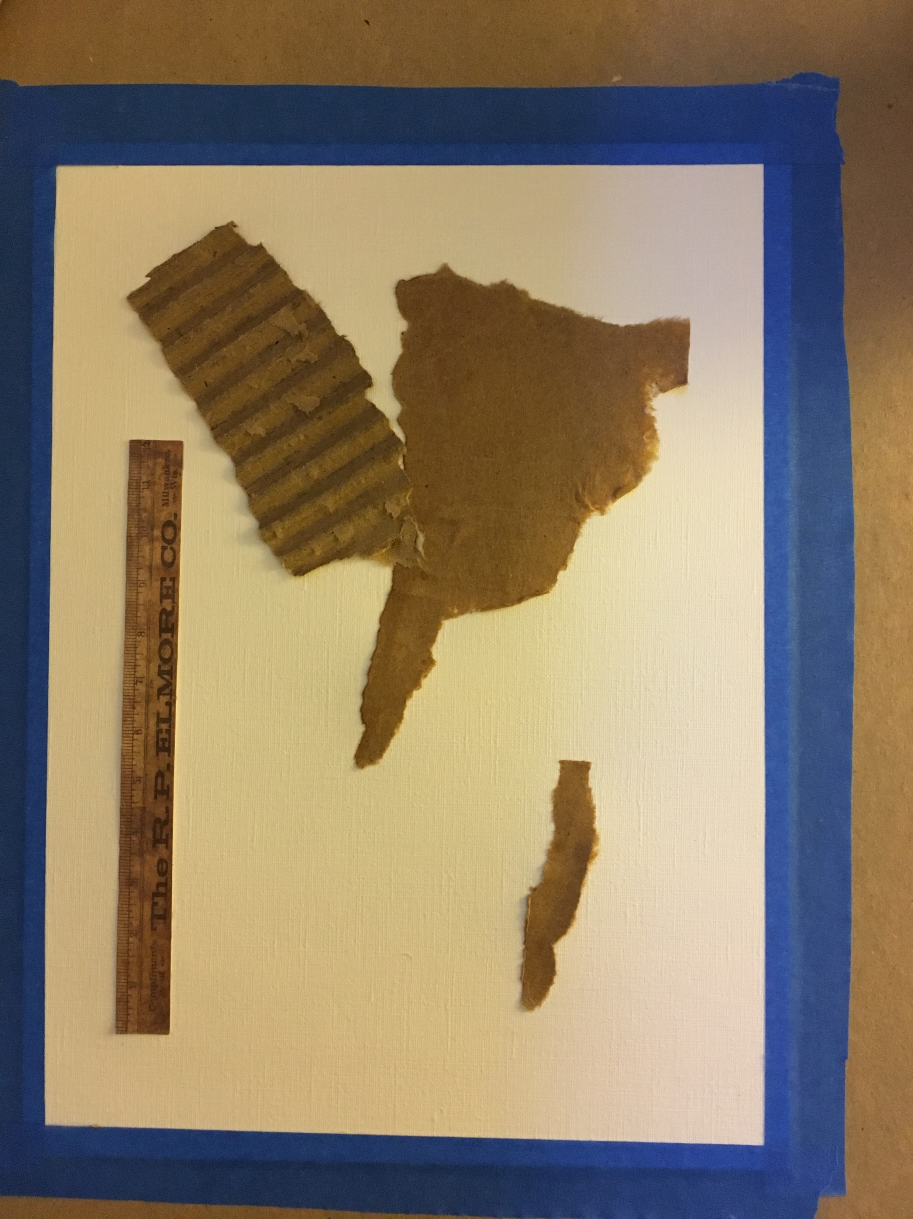
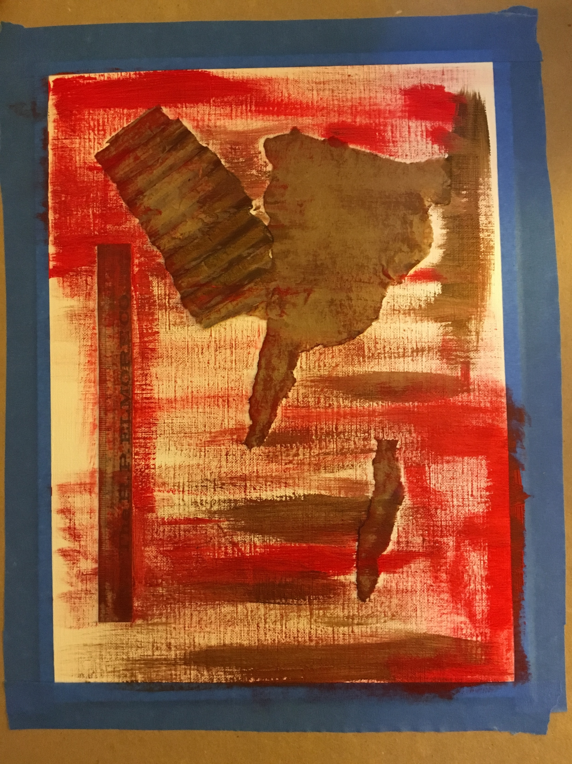
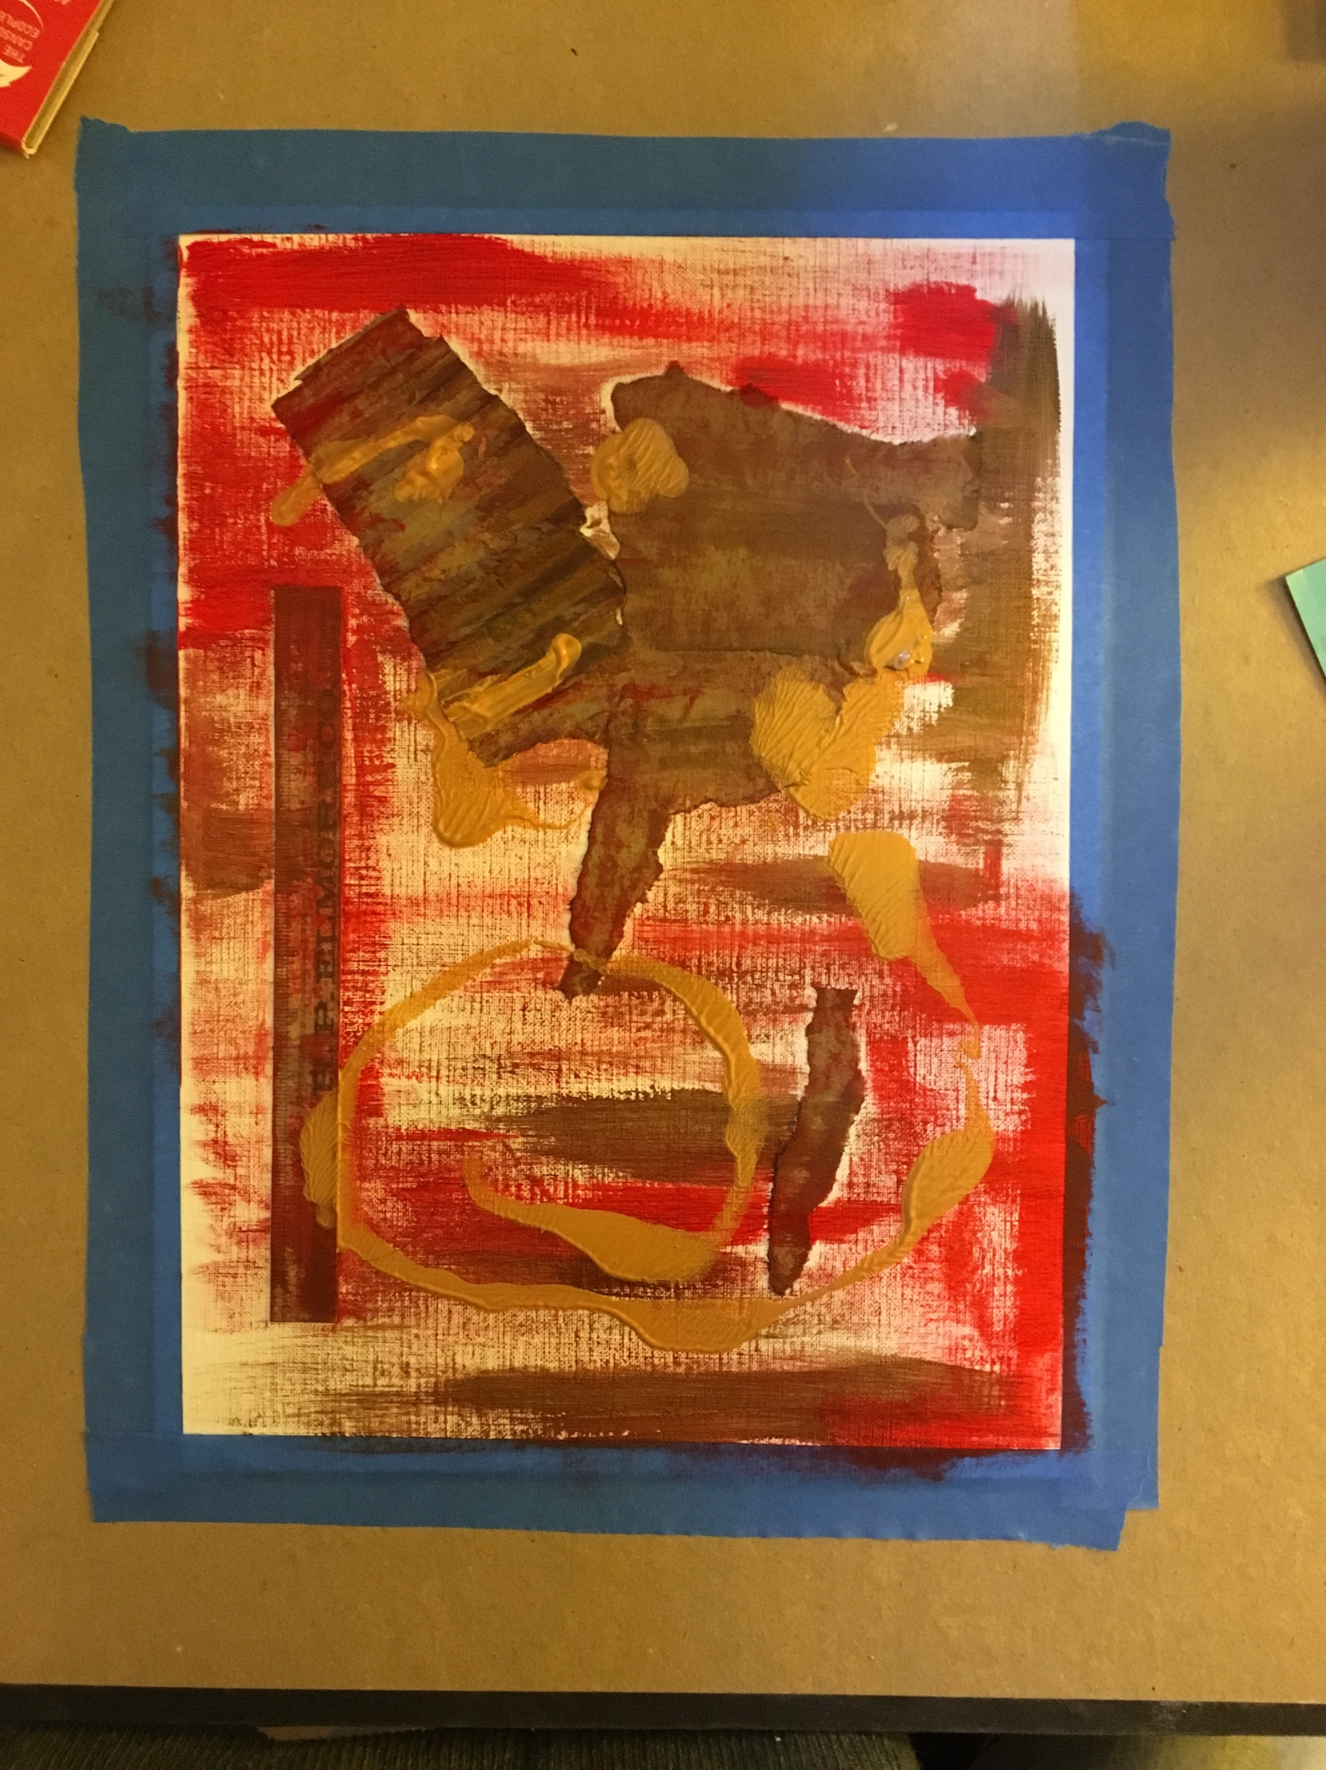
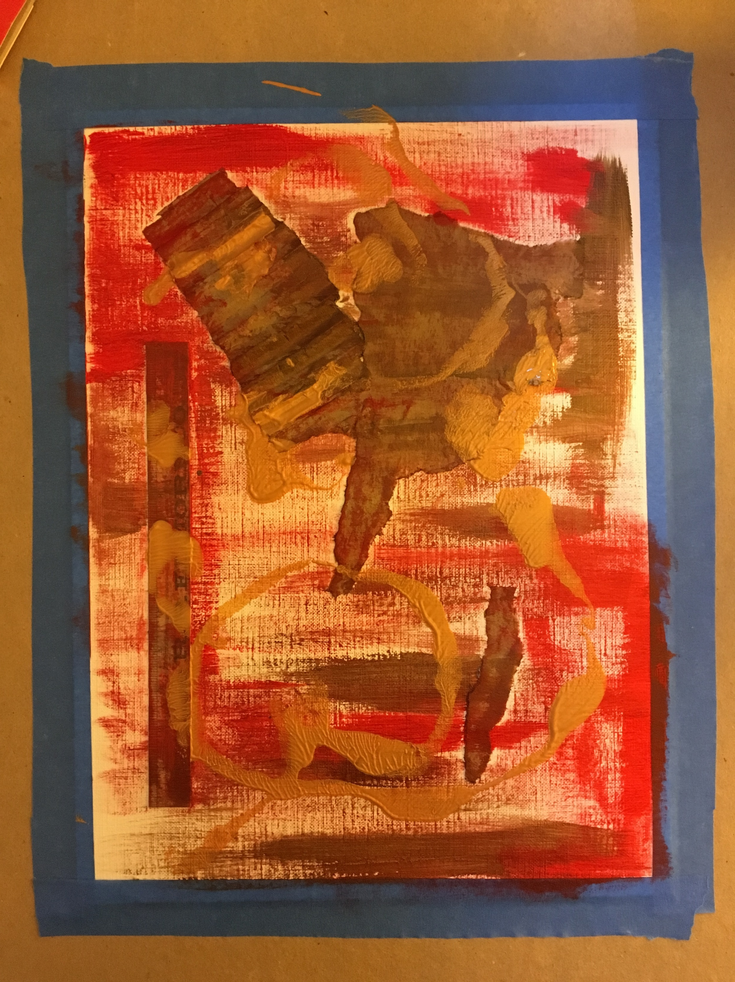
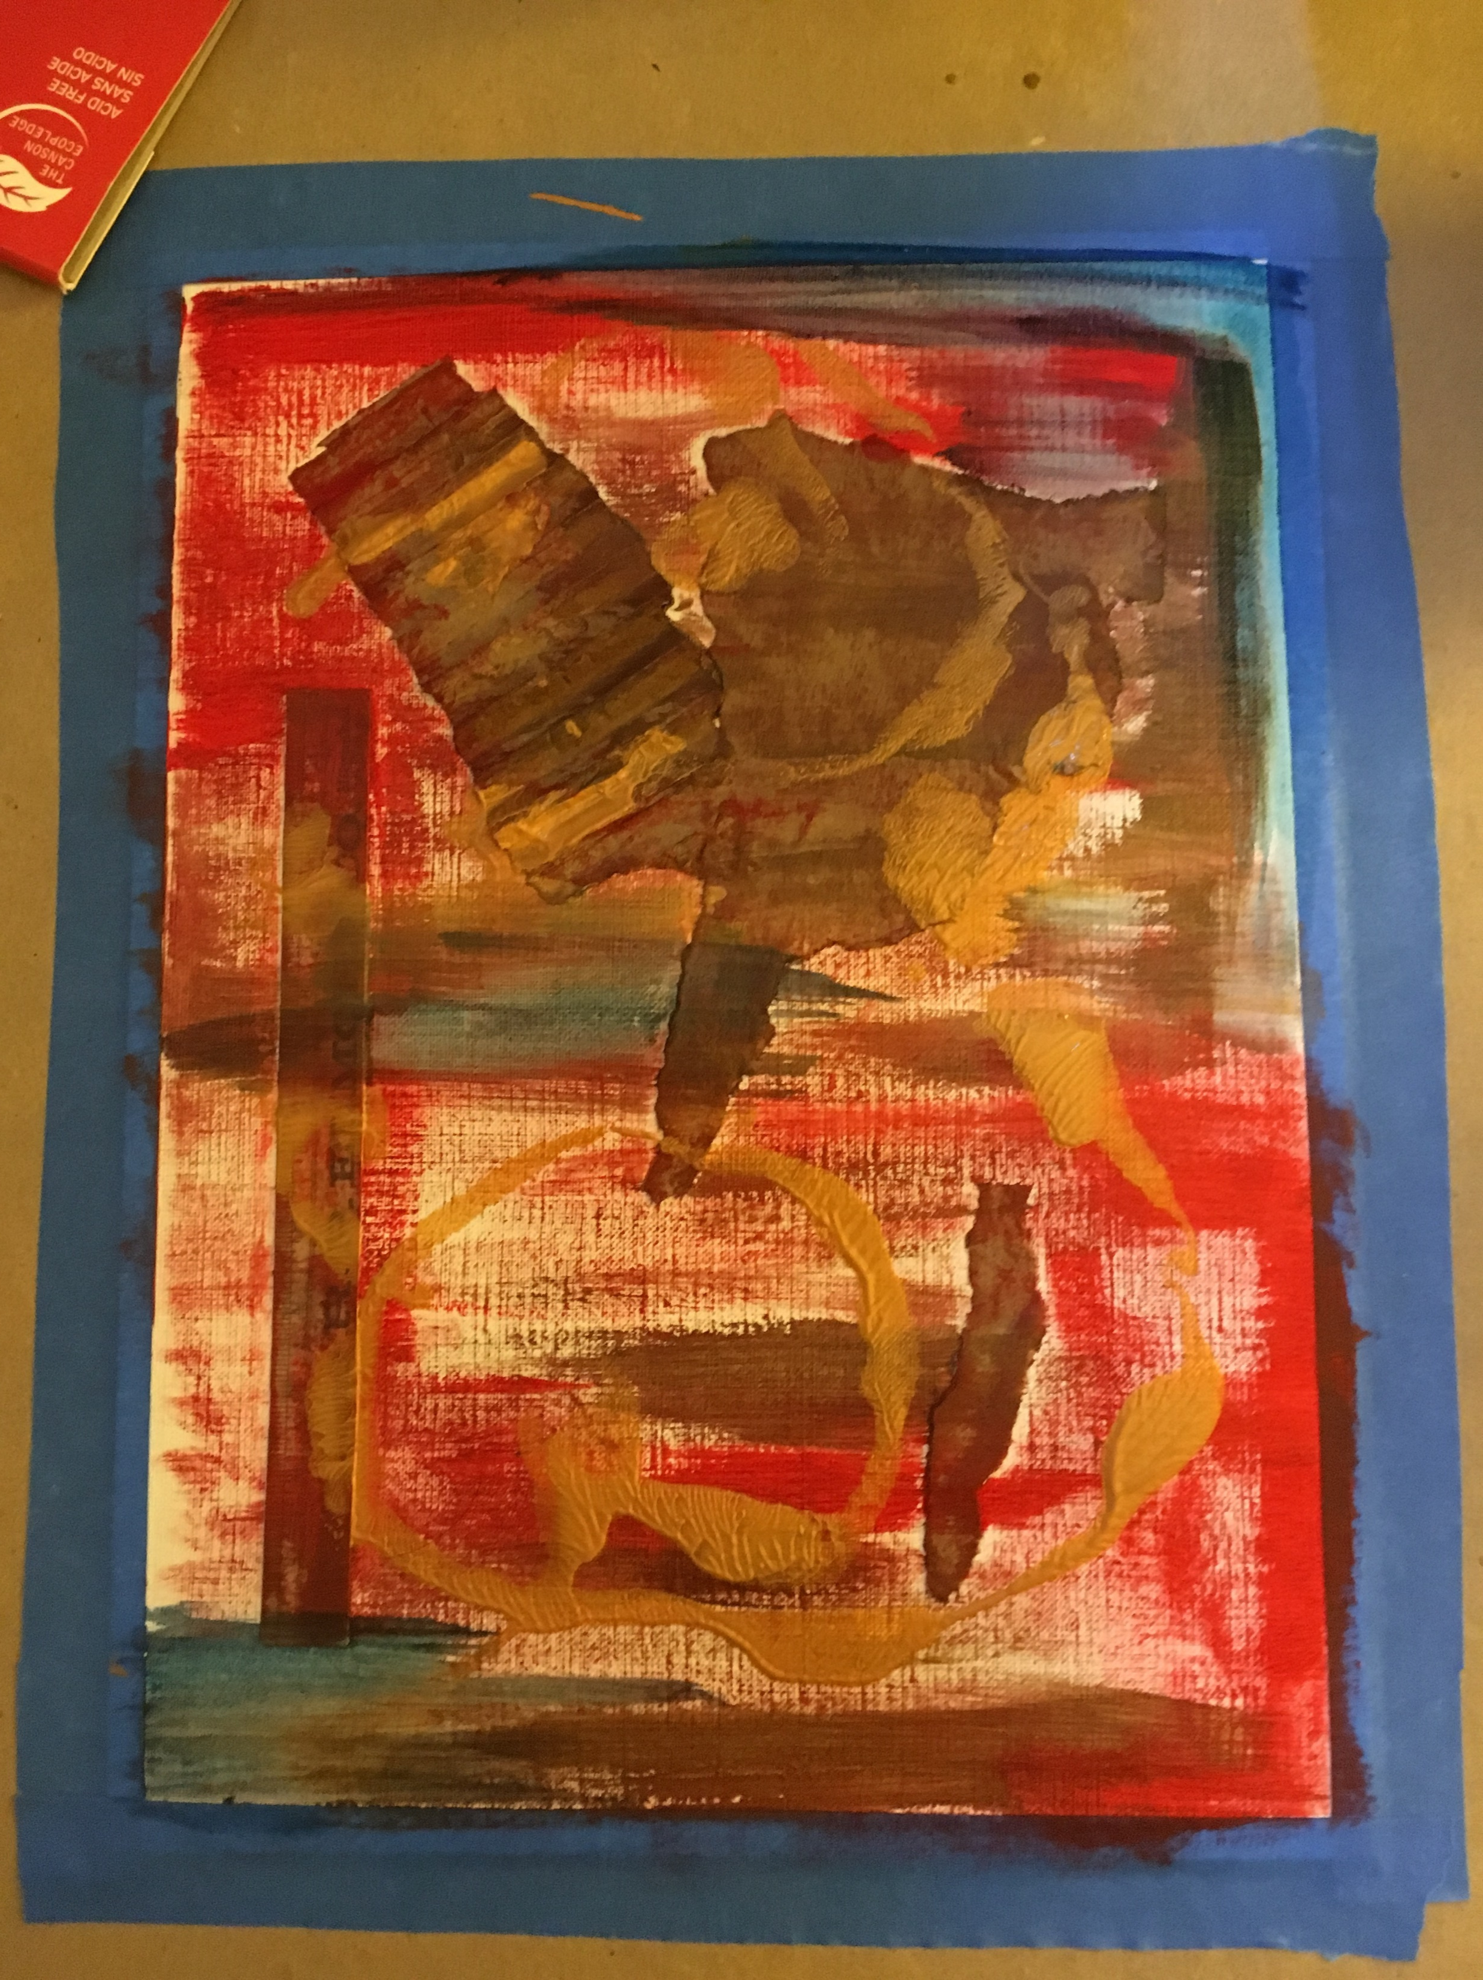
Mixed Media Painting
Directions:
Start with collage elements
Apply paints and other media as desired based on the options (use hair dryer as needed)
You will need:
Canvas paper
Mixed Media painting flow chart of options

Slide 5
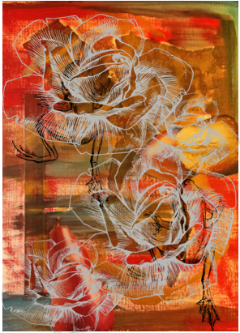
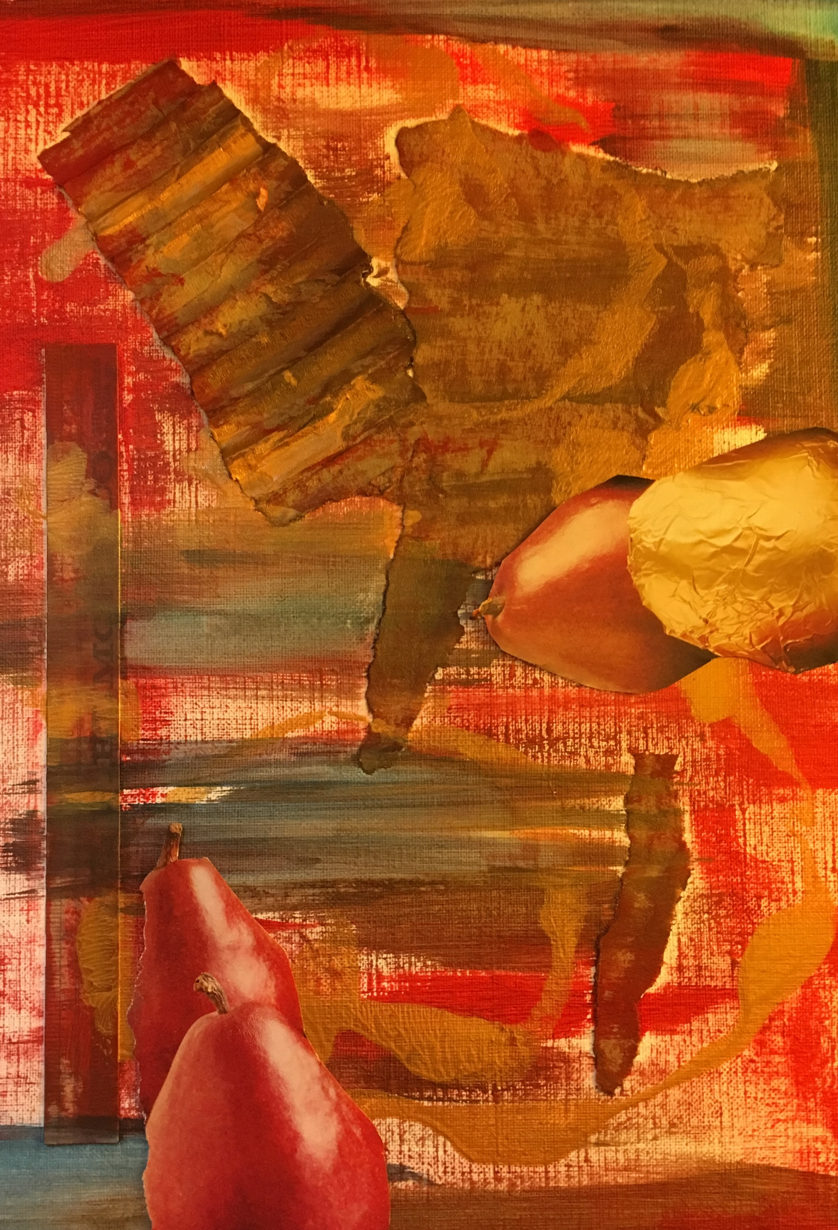
Mixed Media Painting
You will need:
Mixed Media background
Directions:
Apply any additional media or collage elements
Develop subject matter

Slide 6
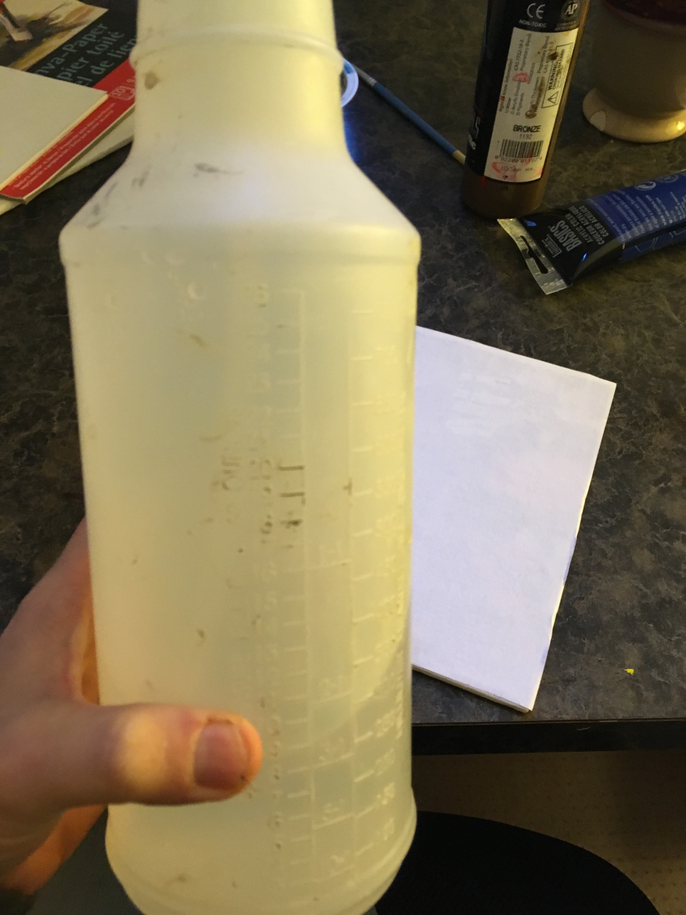
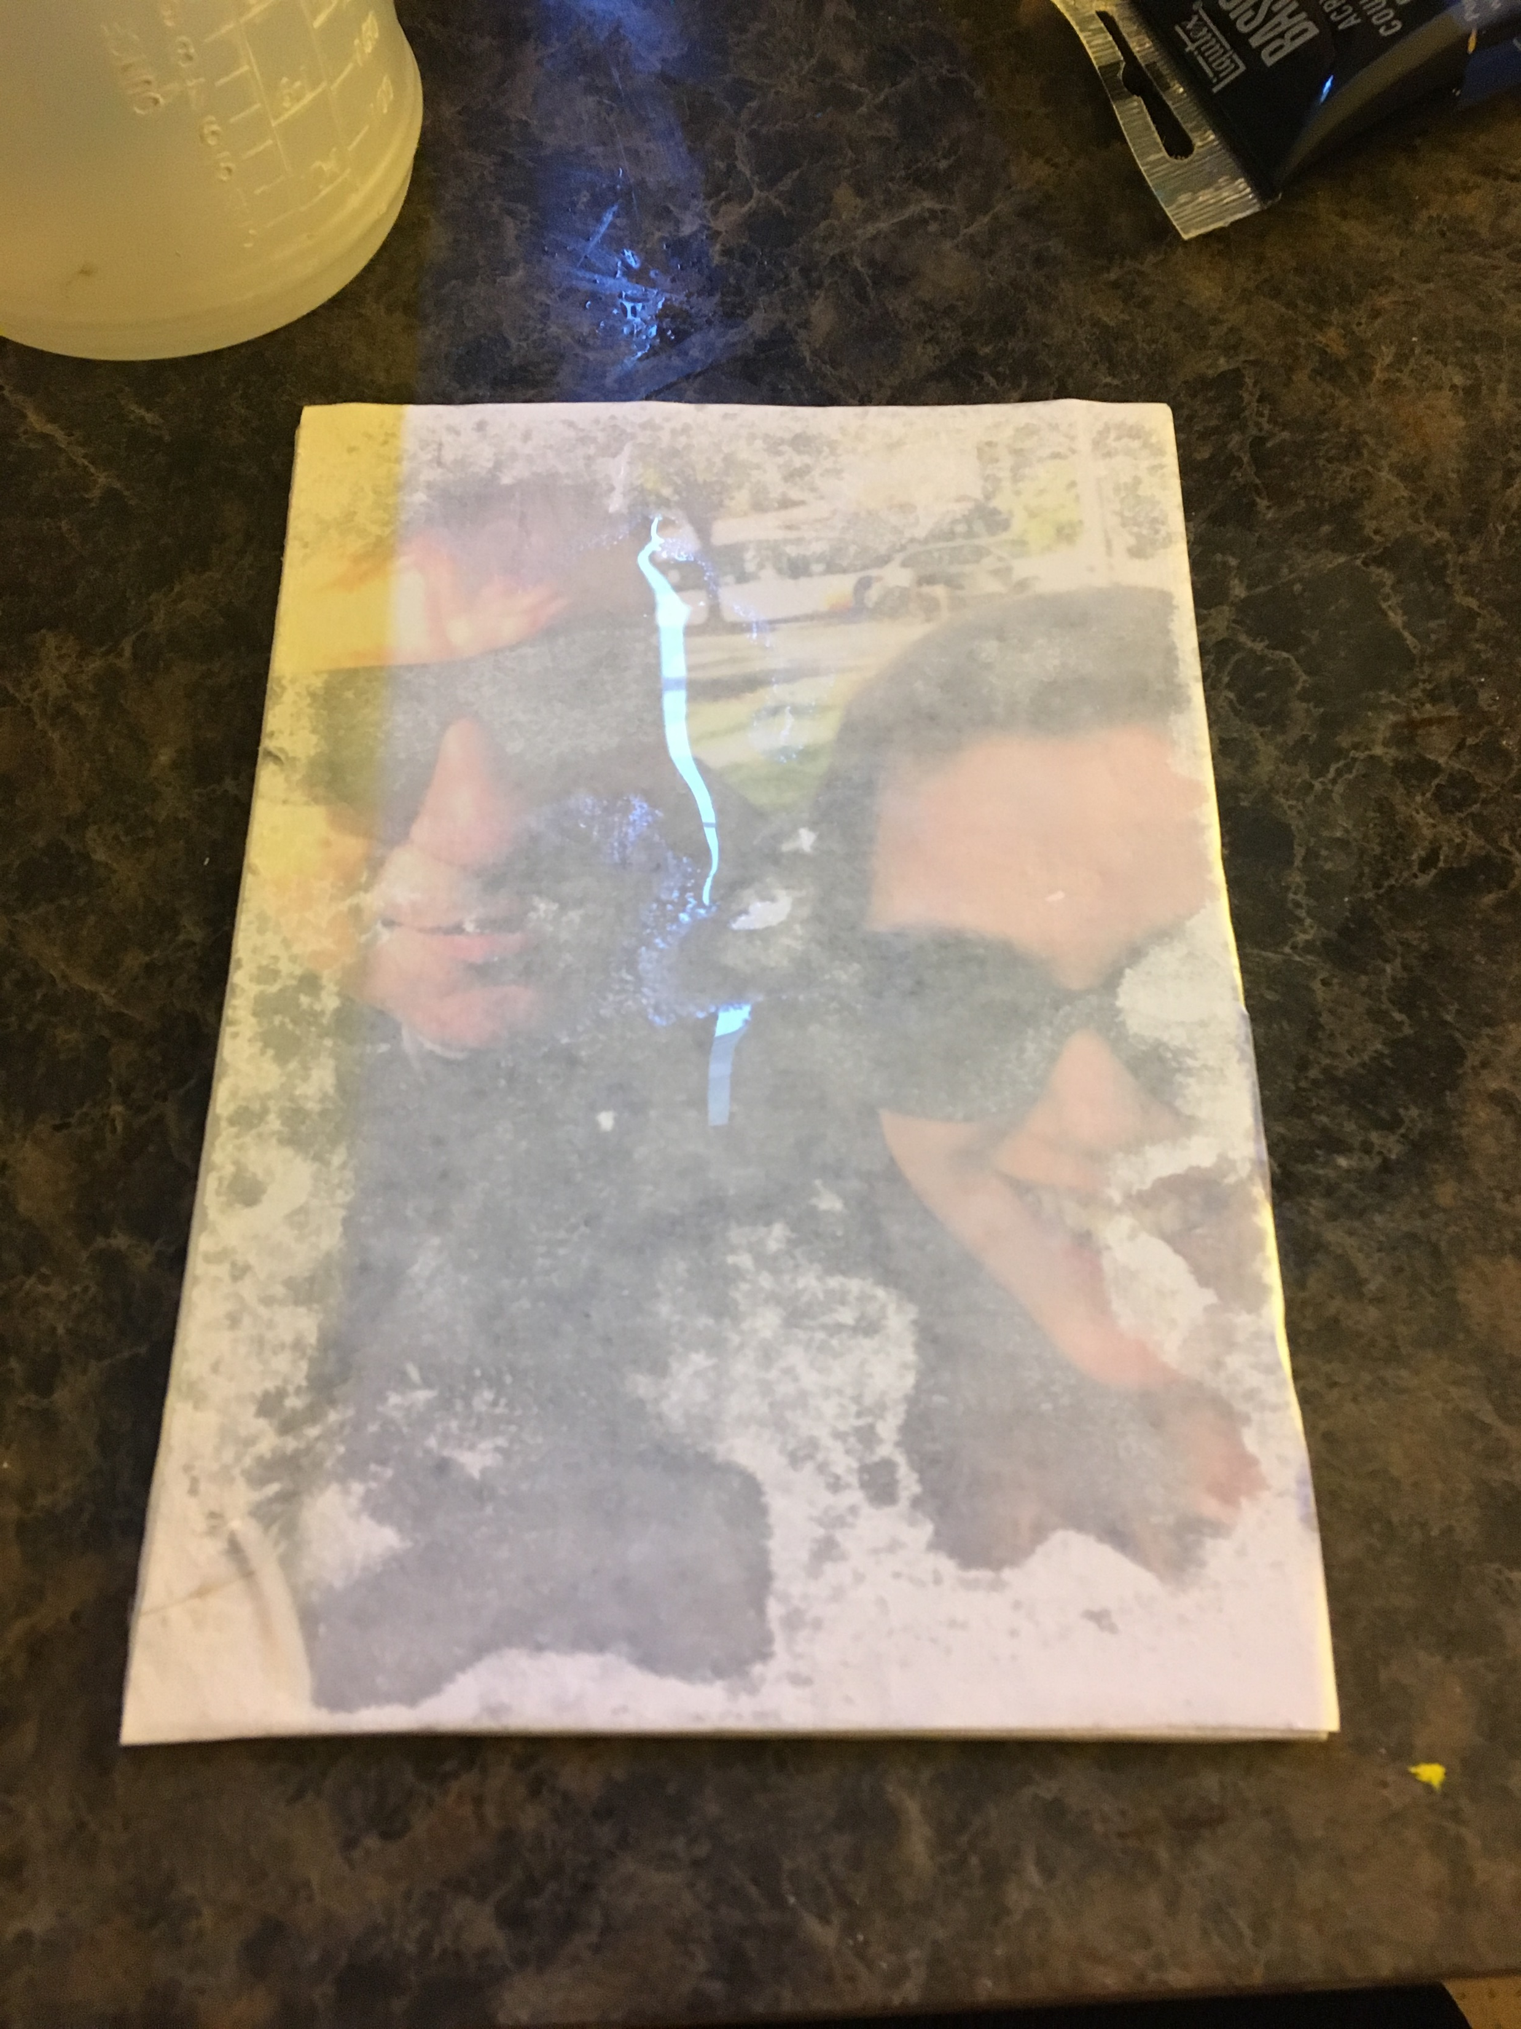
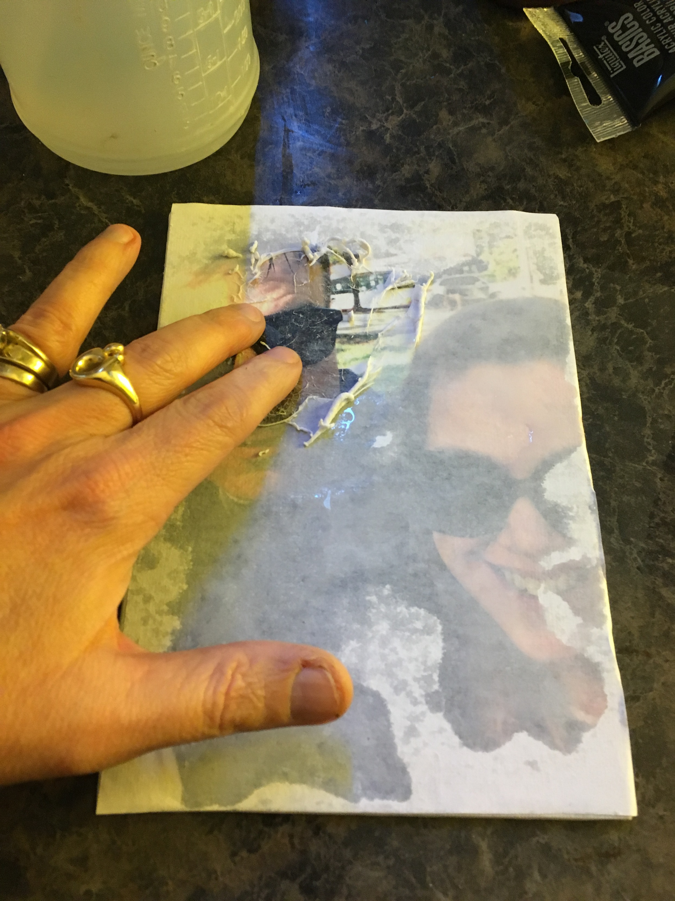
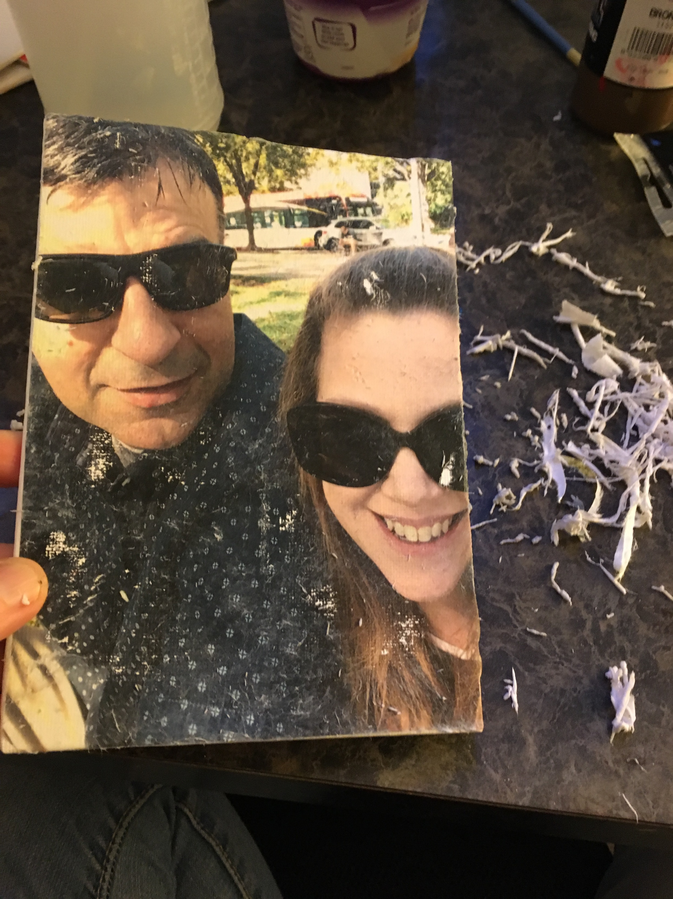
Image Transfer Day 2
Directions:
Spray the back of the imaged your attached to the canvas
Gently rub the paper off, applying water as needed
You will need:
Canvas paper or board from last class
Water Spray Bottle

Slide 7
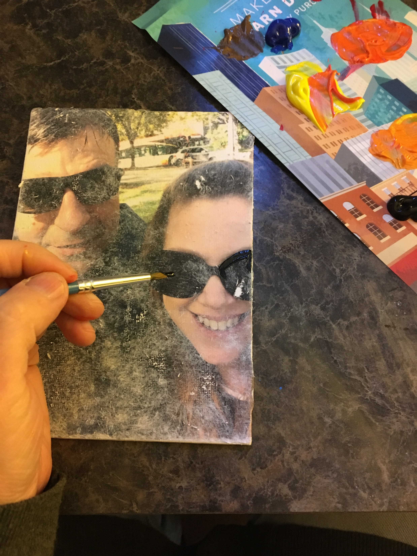
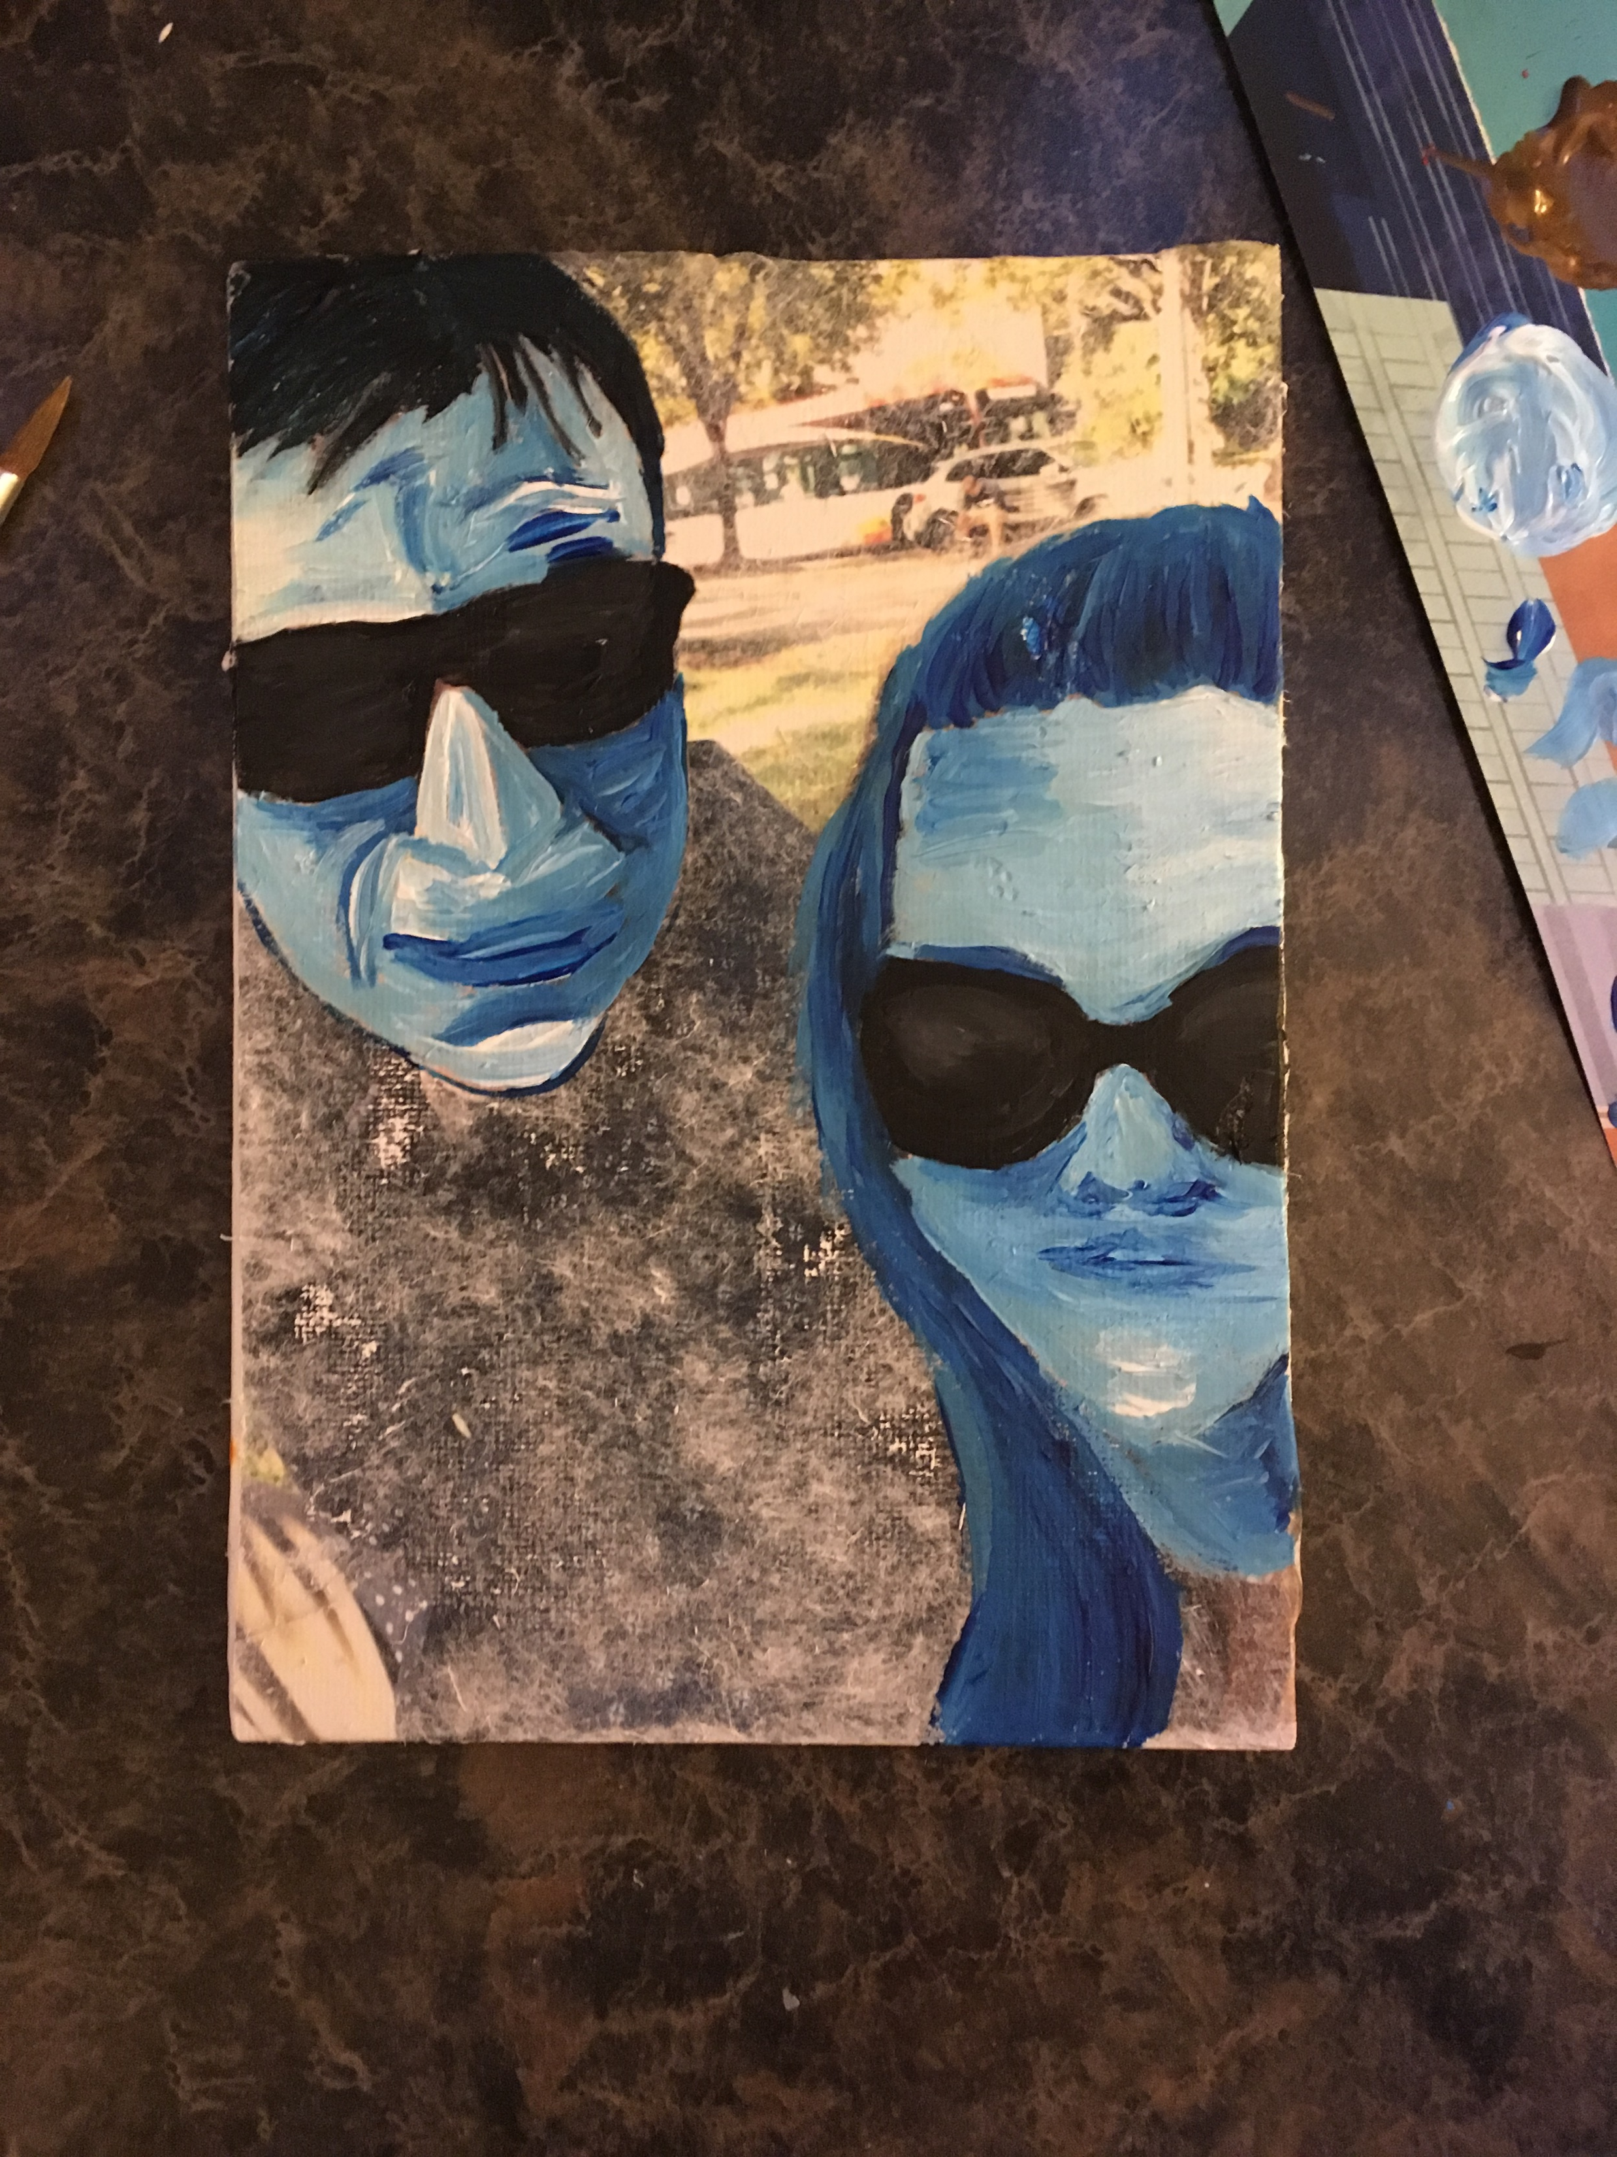
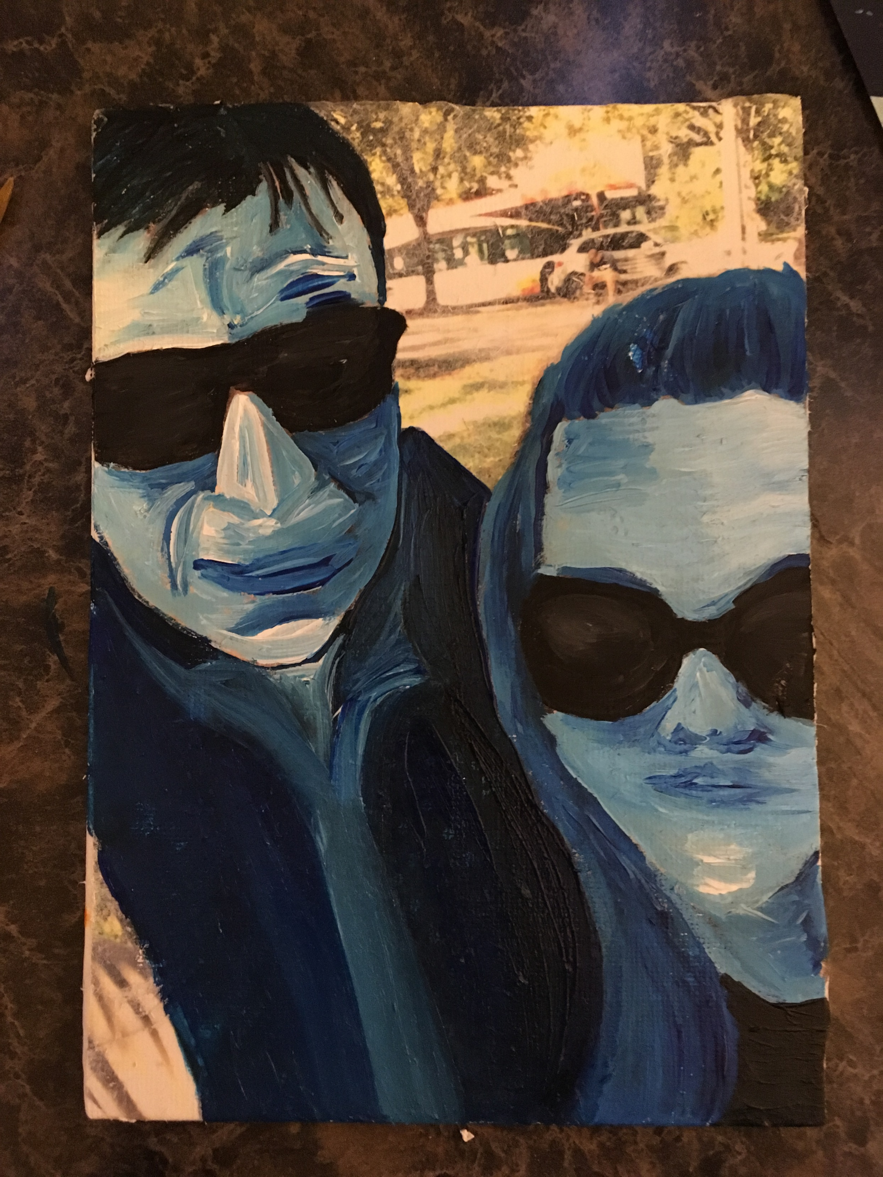
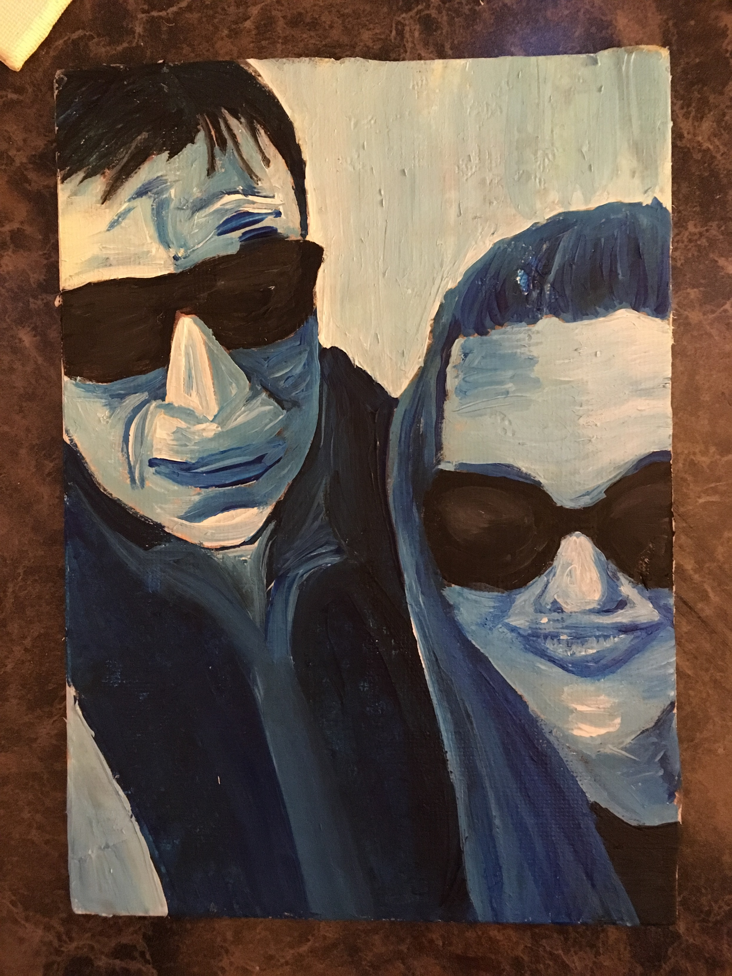
Image Transfer Day 2
Directions:
Set up monochromatic palette
Apply paints paying attention to the different values
You will need:
Transferred image
Acrylic Paints & supplies

