Slide 1
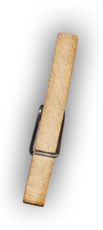
3D Skill Builder
Mixed Media Wire Forms
Drawing with Wire
Pam Ehrenreich pehrenreich@bcps.org mrsestudio48.weebly.com @MrsE_Studio48

Slide 2
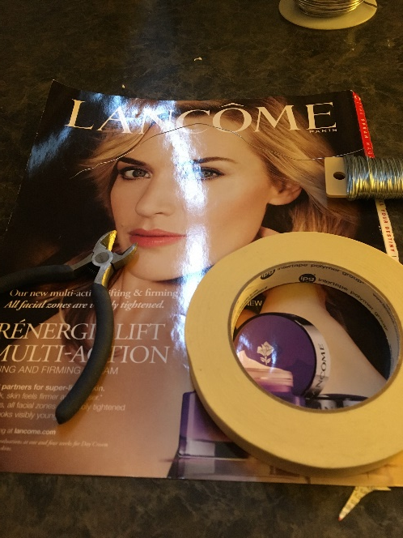
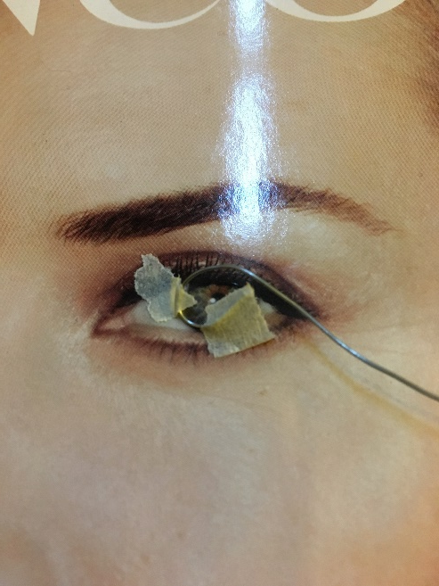
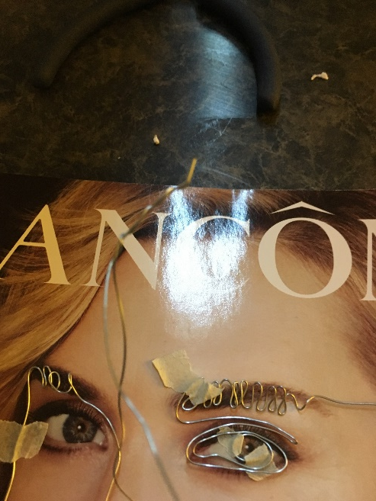
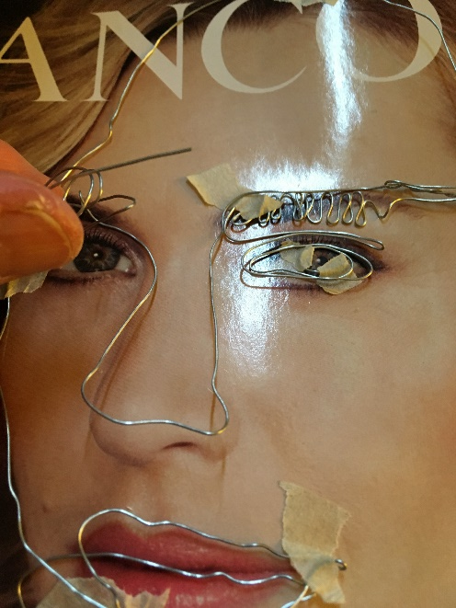
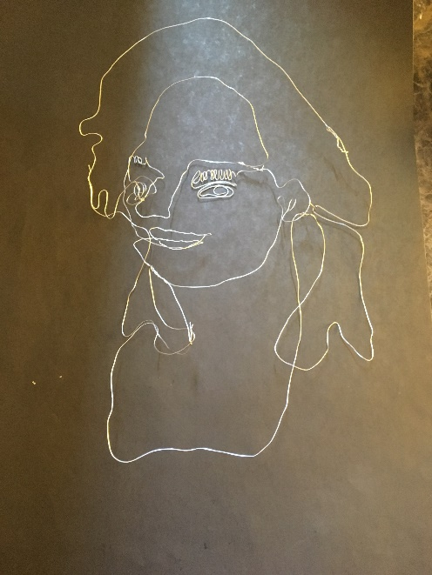
Drawing with Wire
Directions:
Pick a place to start your wire contour drawing and tape in place.
Follow the contour of your image, taping and joining as needed.
Secure to black paper or wood base.
You will need:
An image of a face from a magazine
Wire
Masking tape

Slide 3
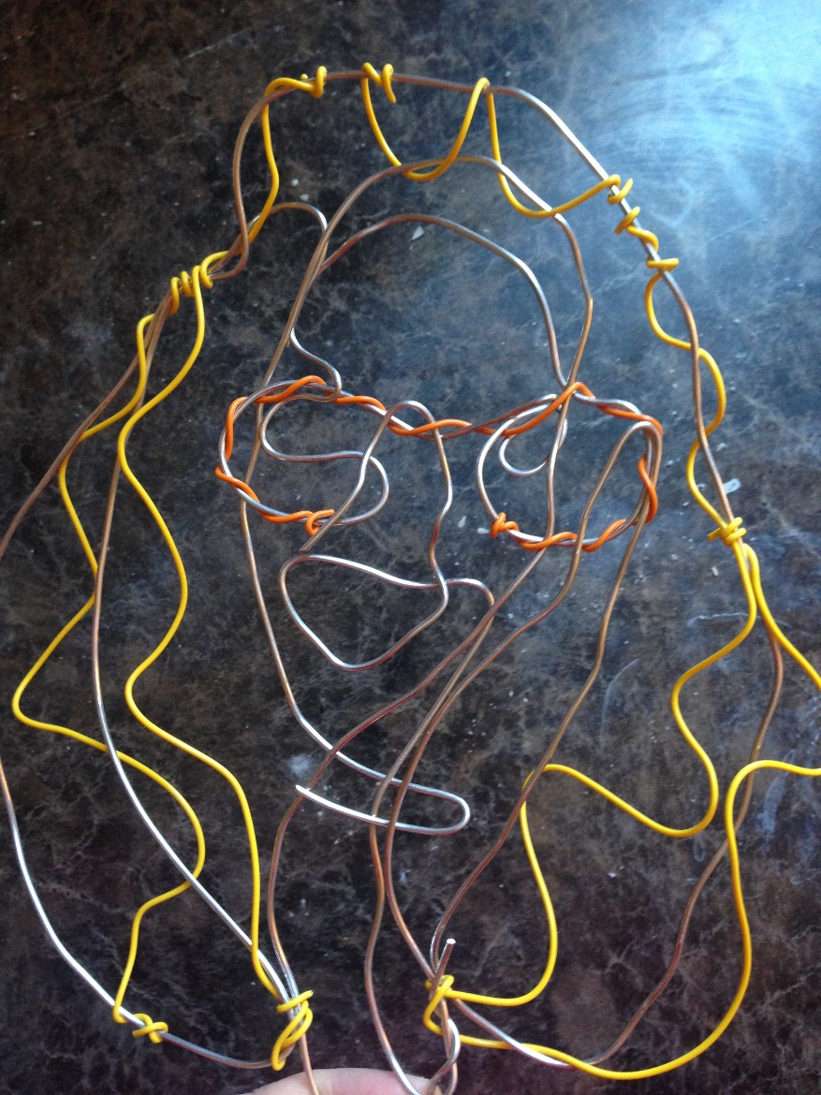
Drawing with Wire
Another Option:
Use thicker wire and or colored wire
Attach to base
You will need:
An image of a face from a magazine or selfie printed out
Wire
Masking tape

Slide 4
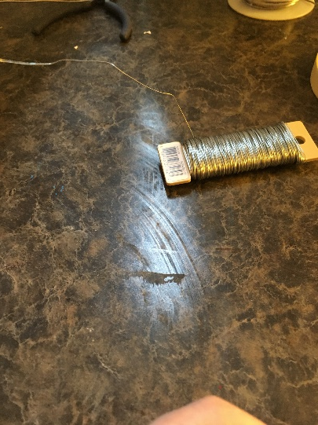
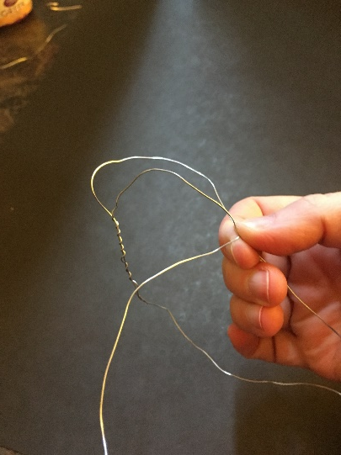
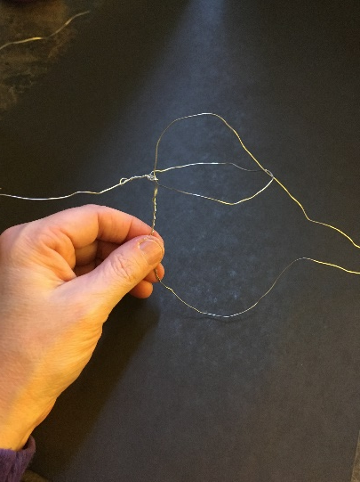
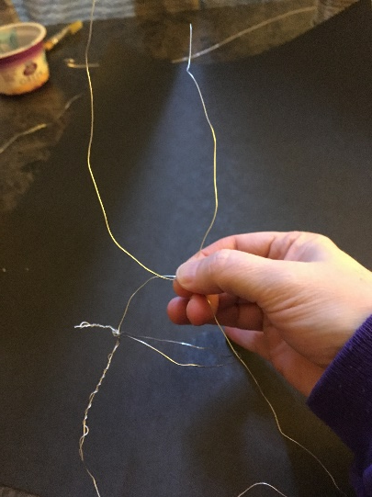
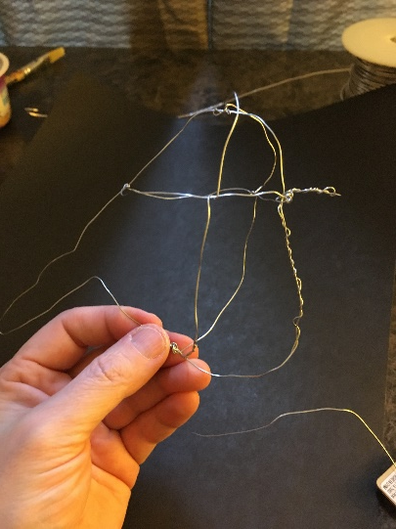
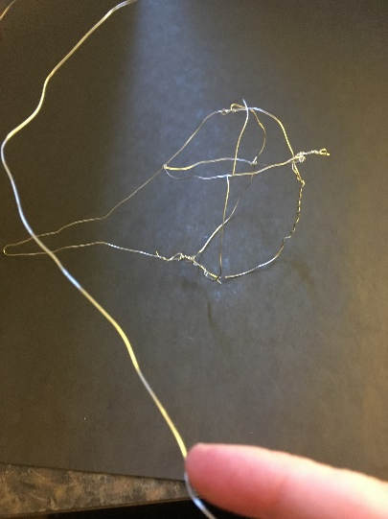
Mixed Media Wire Forms
Directions:
Decide if you will work from the instruction sheet for a bird or if you will observe an object of your choice.
Start basic contour / structure…
You will need:
Wire
Bird handout and or object

Slide 5
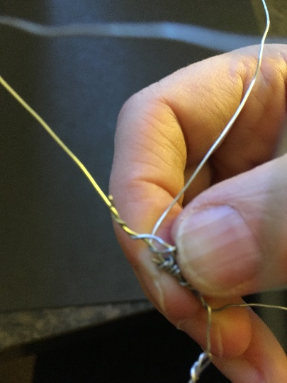
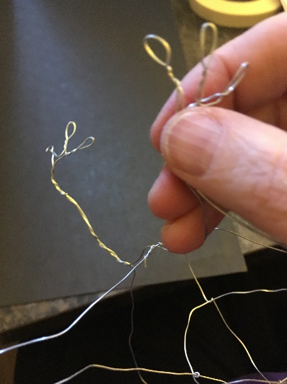
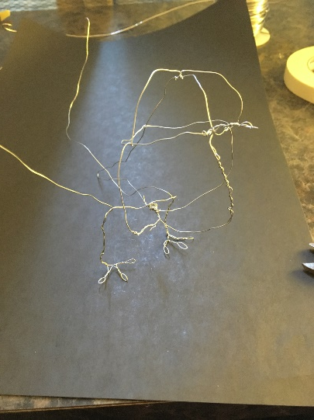
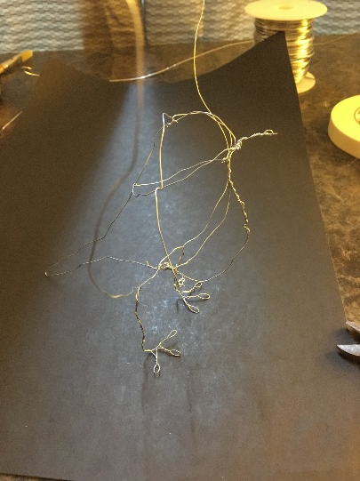
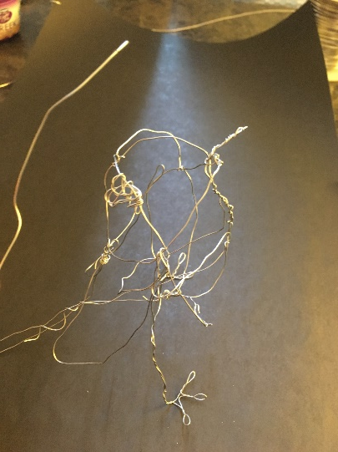
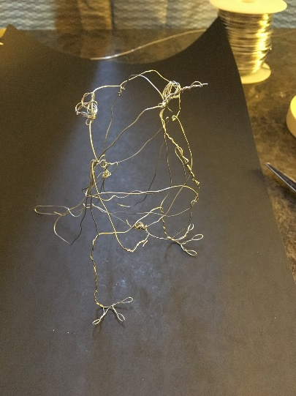
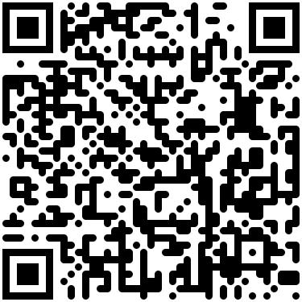
Mixed Media Wire Forms
I followed the directions for the bird …sort of ☺
You will need:
Wire
Bird handout and or object

Slide 6
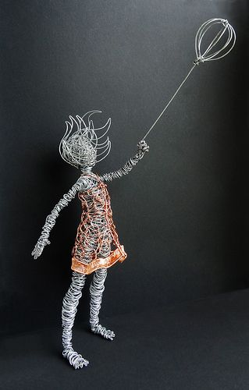
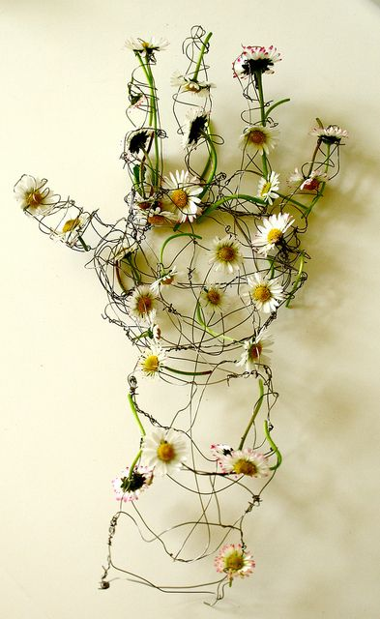
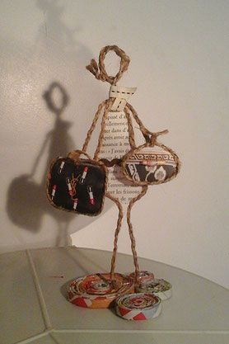
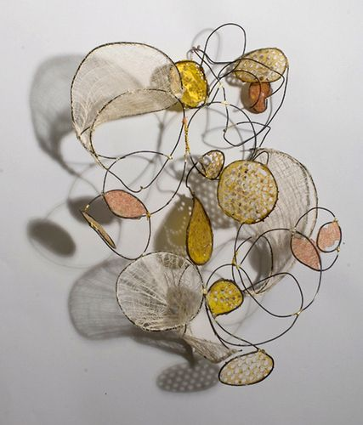
Mixed Media Wire Examples

Slide 7
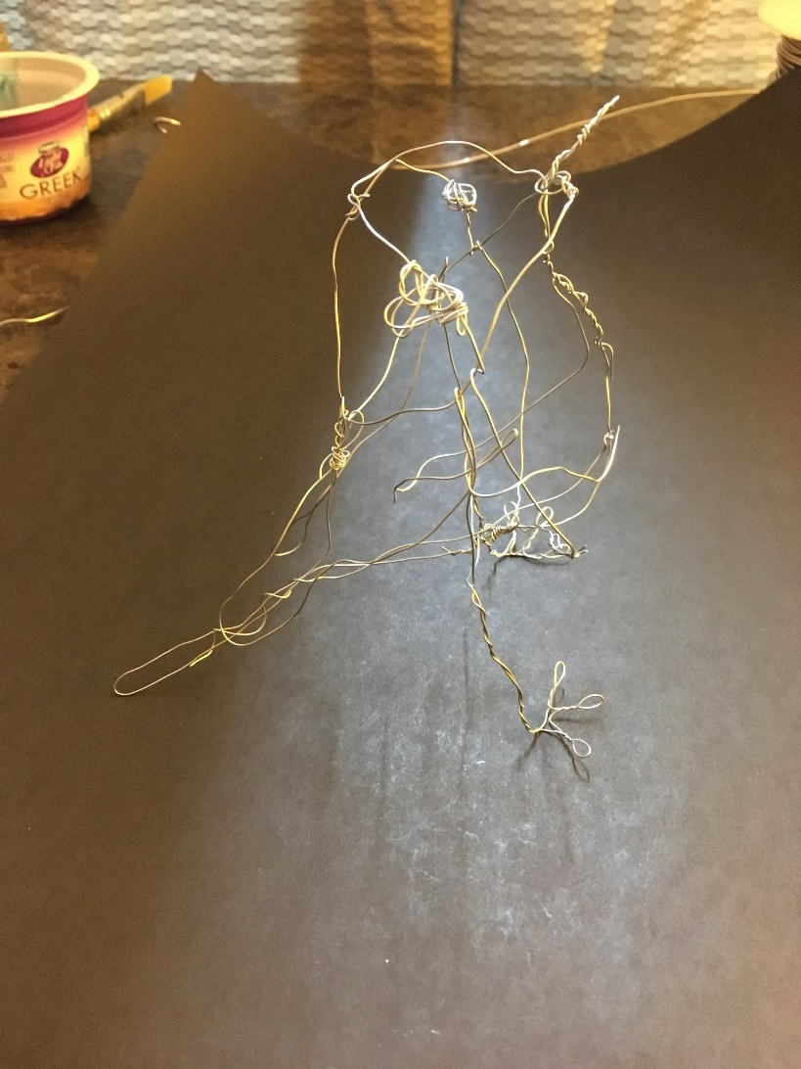
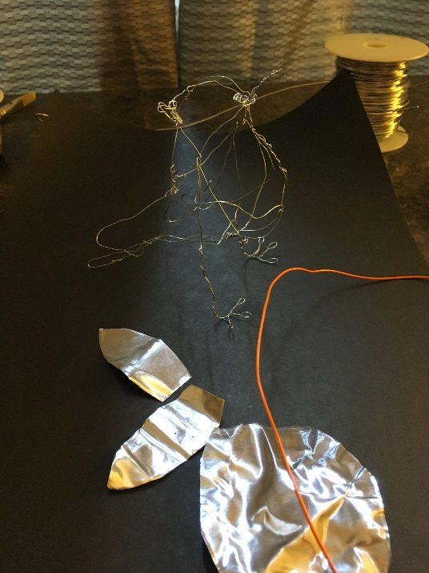
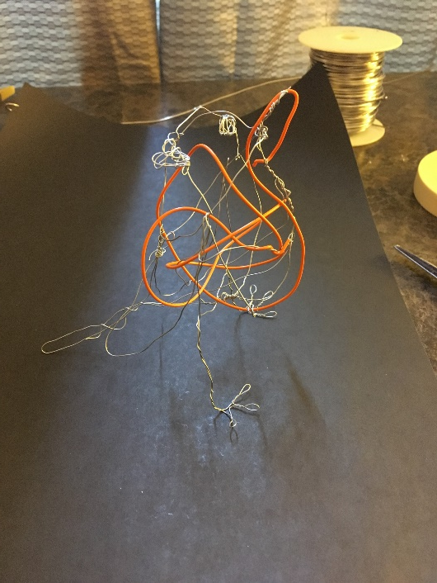
Mixed Media Wire Forms
You will need:
Wire Form
Directions:
Consider adding paper, colored wire, metal…

