Slide 1
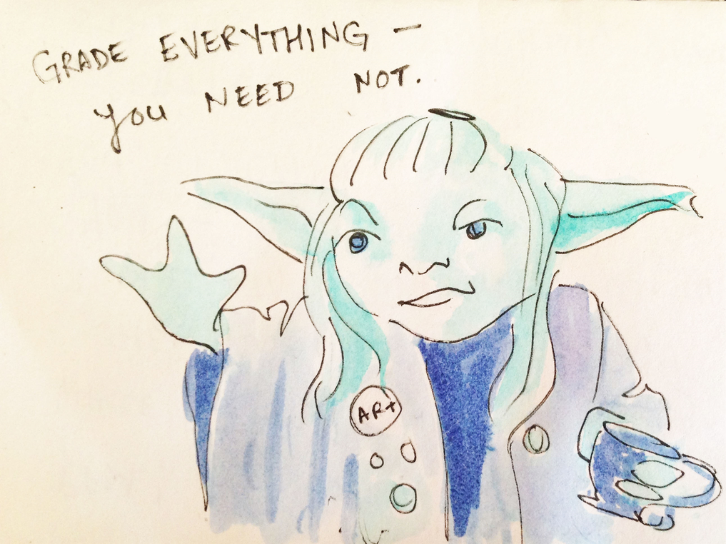
Not Your Typical Gradebook Pam Ehrenreich Art Department Chair Chesapeake High School Baltimore MD pehrenreich@bcps.org mrsestudio48.weebly.com @MrsE_Studio48

Slide 2
Credits…
Kathy Douglas
Diane Jaquith
Clyde Gaw
Nan E. Hathaway
Marvin Bartel
Anne Bedrick
Ian Sands
Melissa Purtee
TAB website, TAB Institute, TABSTOCK, TAB FB forums…

Slide 3
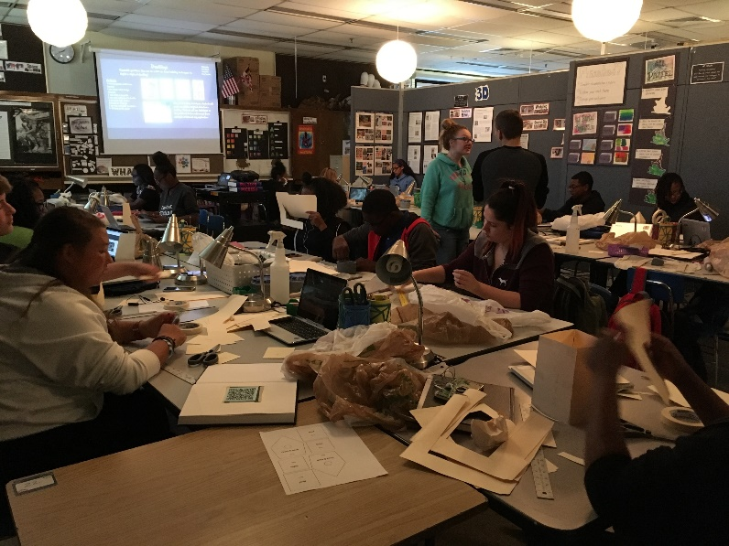
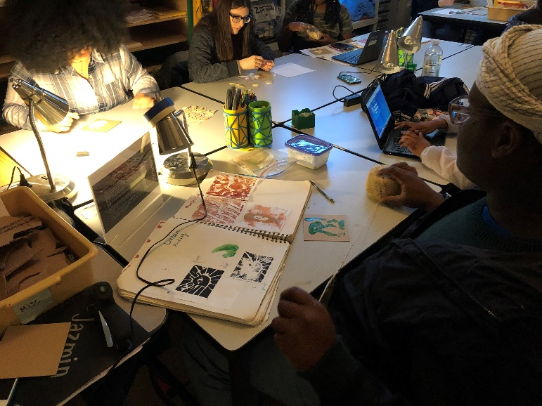
I teach: Clay 1 & 2
Studio Practice
Adv Clay Mixed Media
AP (All 3 portfolios)
Average 25 students per class
AP = typically 6-12
Always taught in high needs environments
I taught Middle School for 18 yrs.
HS for the past 6 yrs.
Practicing some form of choice for 15 yrs.
Teaching for Artistic Behavior 9 yrs.

Slide 4
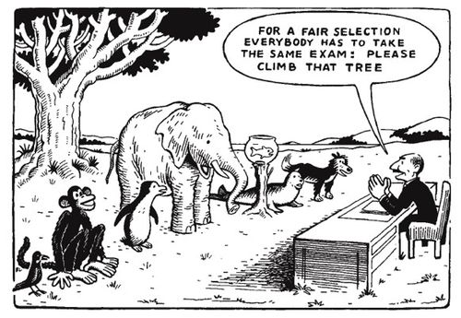
Fair is not equal & doesn’t give an accurate picture of what students can do.

Slide 5
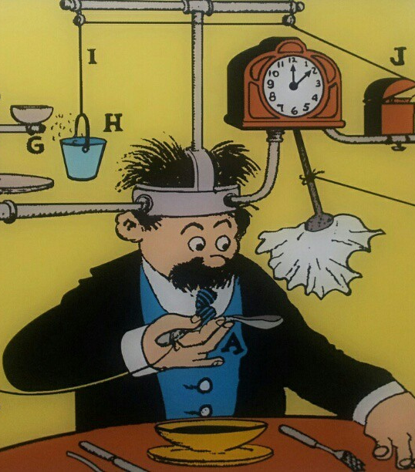
Process Over Product Constraints & Realities
Rube Goldberg https://www.google.com/url?sa=i&source=images&cd=&cad=rja&uact=8&ved=2ahUKEwi7ypmVmcPgAhUGd98KHYOOBn0Qjhx6BAgBEAM&url=https%3A%2F%2Fwww.flickr.com%2Fphotos%2Fvanhoosear%2F8382403596&psig=AOvVaw3sGHeaShS3pcTUM9Pzhn8H&ust=1550507624299226

Slide 6
Constraints
New district grading policy effective 2016-17
Bi-weekly grade requirements
No homework, no extra credit, no participation grades
Formative & Summative
50pt grading scale
Standards- based Grading
Danielson

Slide 7
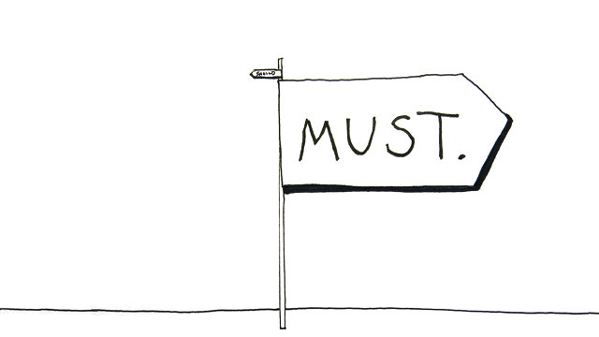
School Expectations
Practice vs Assignments (2/3 vs 1/3)
Must allow re-do
Learner Centered Environments – focus on Personalization
Grades should reflect what students know & can do = Artwork and reflection

Slide 8
Danielson Edu-Speak
Differentiated for individual needs
Criteria is clear (and developed by students)
Evidence of thinking / learning
Evidence used to plan further instruction
Timely feedback
Students self assess & maintain evidence

Slide 9
Danielson, National Standards Personalization TAB

Slide 10
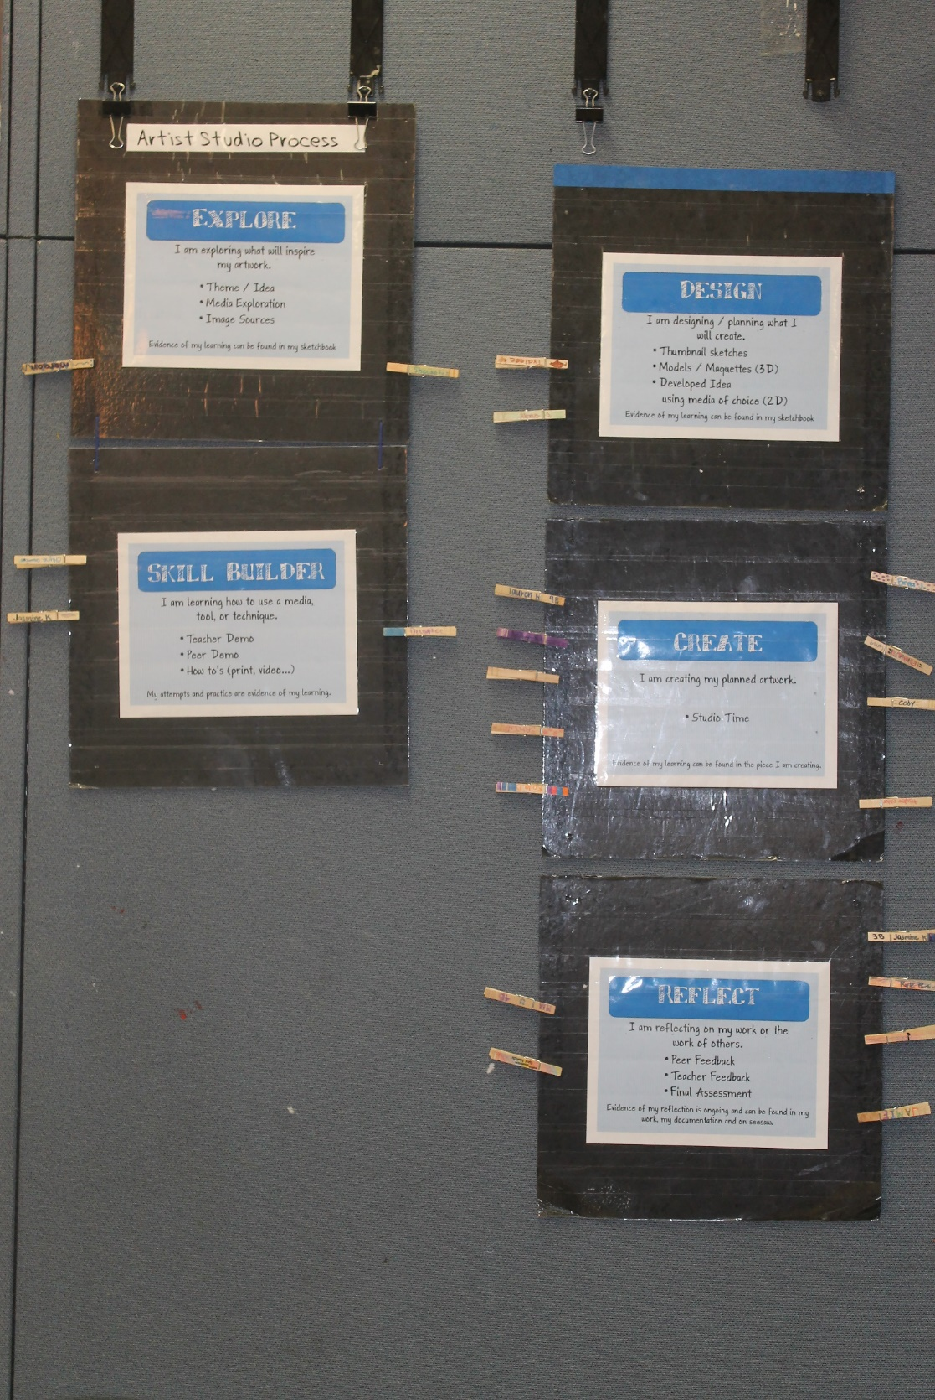
Artist Studio Process Explore, Design, Skill Builder, Create, Reflect
Allows for personalization
Students Self Assess
Daily feedback based on where student are in the artistic process
Growth mindset
Aligns with standards & SHoM

Slide 11
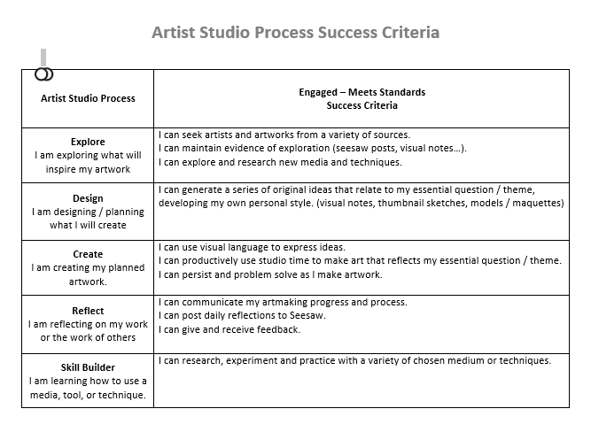
Success Criteria
Daily engagement feedback aka practice grades & Formative Assessment!

Slide 12
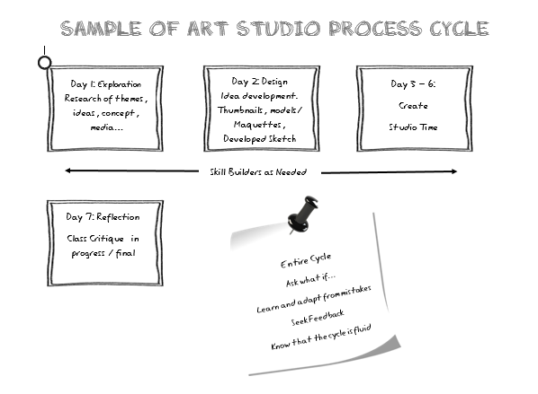
7 Day Cycle

Slide 13
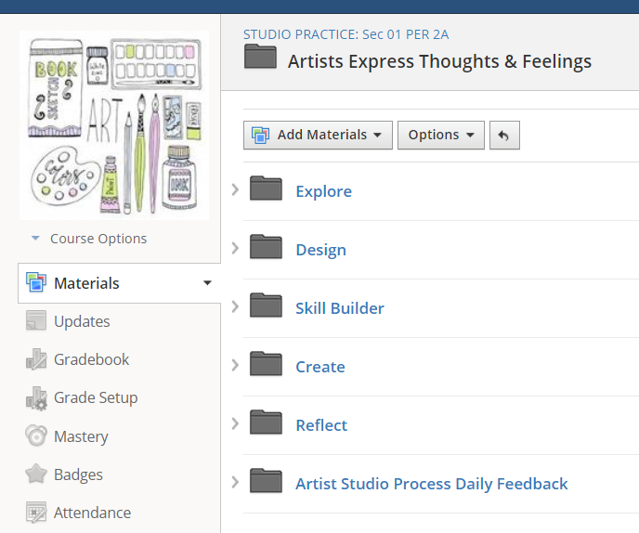
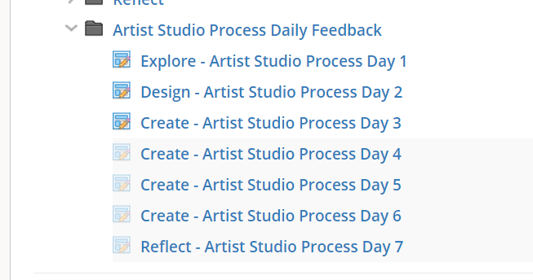
Formative Assessment
7 Day Cycle
3 cycles per quarter

Slide 14
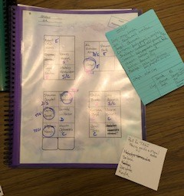
Tracking Progress & Formative Assessment

Slide 15
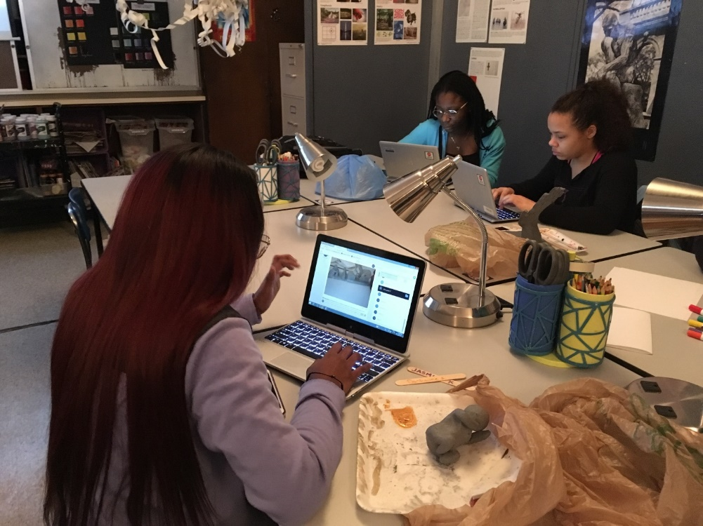
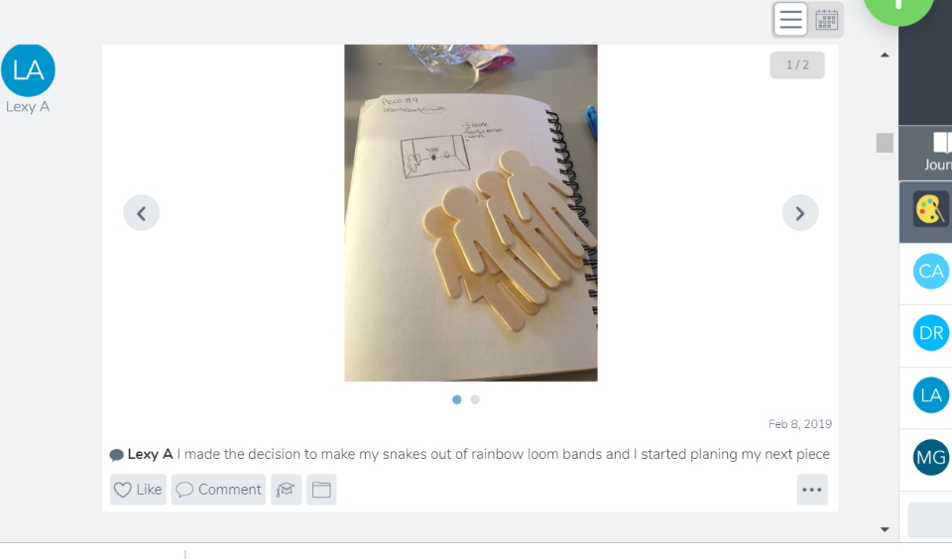
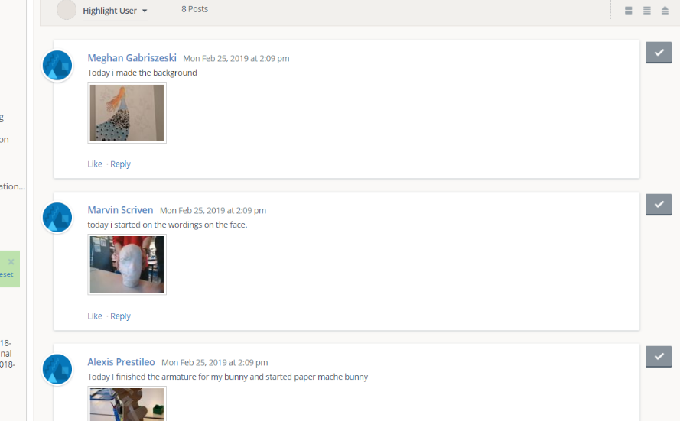
Tracking Progress
Where are you in the Artist Studio Process? What artistic decisions did you make today and how did they affect your work.

Slide 16
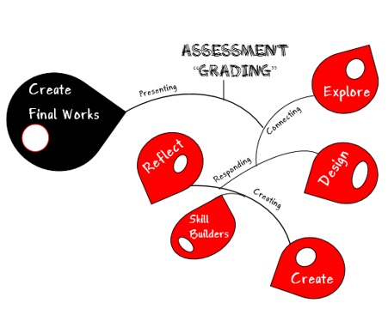
Summative Assessment
Balance of major & minor “assignments”

Slide 17
Summative Assessment of the Process
Why I “grade” the evidence…
50
90
98

Slide 18
The Hot Mess Gradebook
Daily ASP “practice” grades based on success criteria with comments. Each phase of the studio process is “graded” when students feel they are ready, have evidence, and demonstrated their learning.
 | ASP 1 | ASP 2 | ASP 3 | ASP 4 | ASP 5 | ASP 6 | ASP 7 | Explore | Design | Skill builder | Create | Reflect
Student 1 | Explore 23/25 | Design & Skill builder23/25 | Create23/25 | Create 23/25 | Create 23/25 | Create LS/25 | Reflect 23/25 | 23/25 | 23/25 | 23/25 | 98/100 | 48/50
Student 25 | Explore 23/25 | Design 23/25 | Absent No evidence | Skill Builder 23/25 | Skill builder 50/50 | Create 23/25 | Create23/25 | 23/25 | 23/25 | 23/25
Graded work due by the end of the quarter, no late work, graded based on what was completed vs not completed.

Slide 19
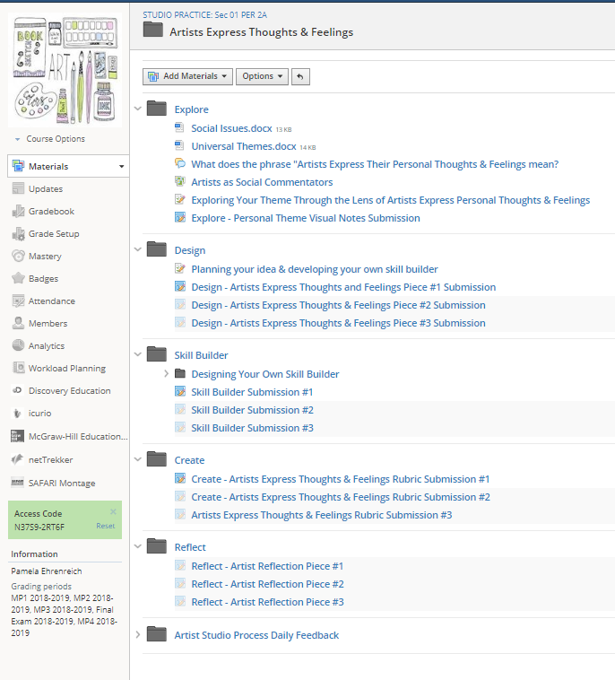
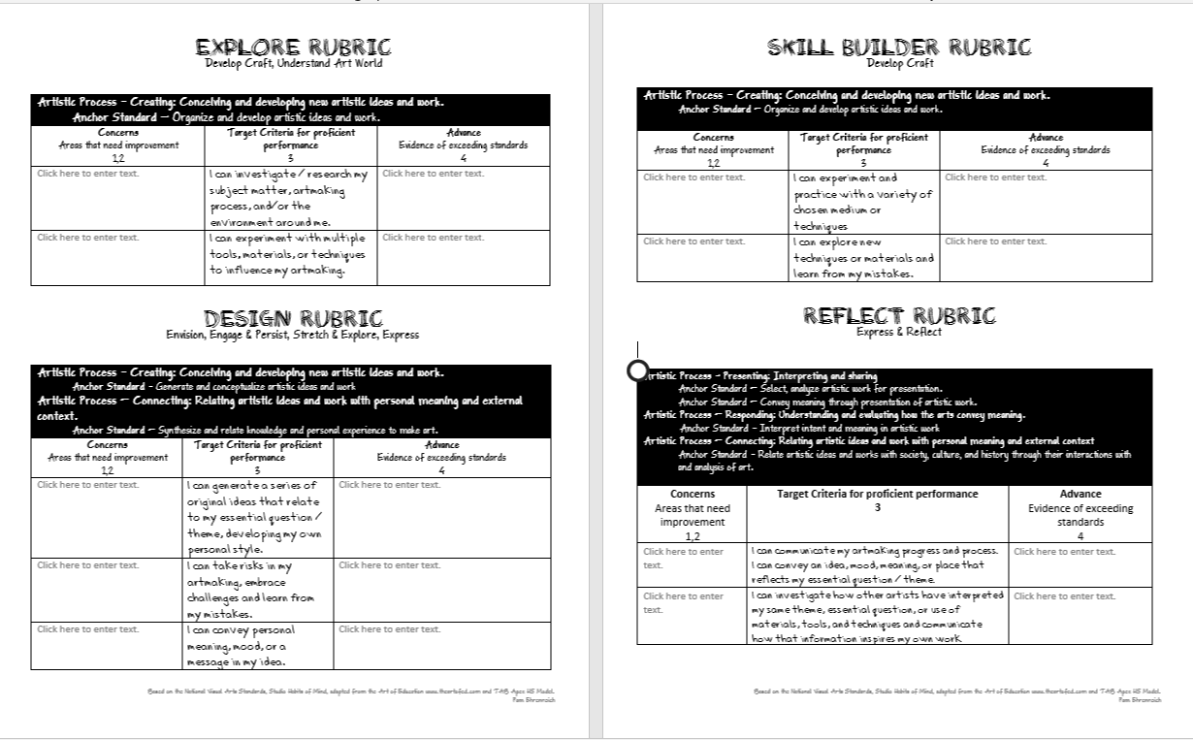
Summative Assessment

Slide 20
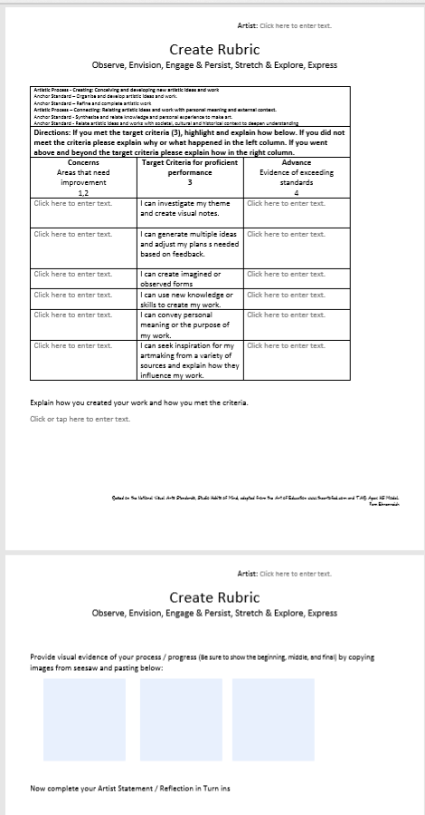
Summative Assessment

Slide 21
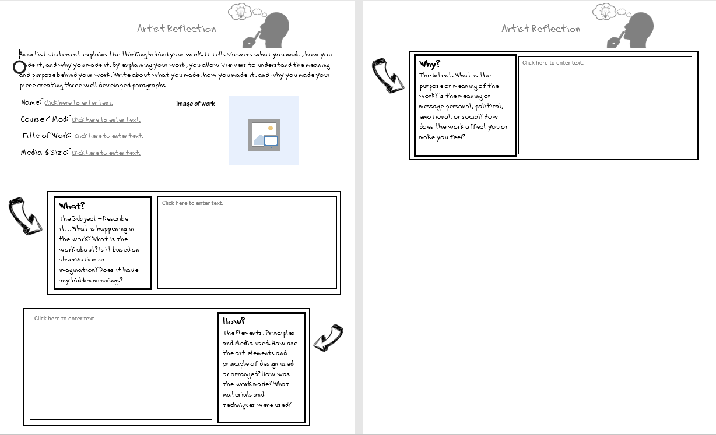
Summative Assessment

Slide 22
Tykeara Story

Slide 23
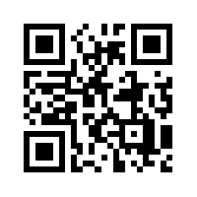
Pam Ehrenreich
pehrenreich@bcps.org
@MrsE_Studio48
mrsestudio48.weebly.com
Rate this session

