Slide 1
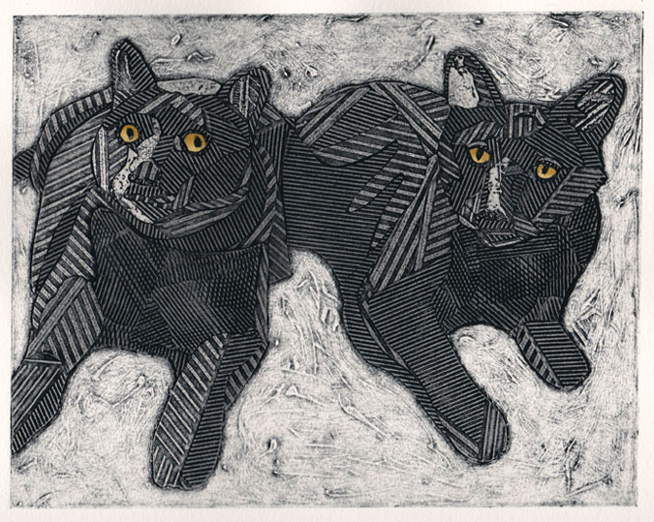
Collagraph
A collagraph refers to a collage of materials glued on to a "printing plate," which is a square of cardboard. When glue is dry, it is shellacked or varnished so that it can be painted with acrylics. Paper is then pressed on to the surface to produce a print.
Bonnie Murray

Slide 2
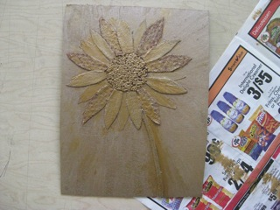
Creating a Collagraph
Process:
Glue various materials onto a cardboard printing plate to create a realistic or abstract image. Some possible materials to use: Cut or torn cardboard shapes, textured paper, fabric, felt, foam shapes, yard, string, leaves, seeds, small twigs. Note: items should of similar thickness.
Apply ink or paint quickly with a brayer or foam brush,
Lay the paper over the inked surface, rub the back of the paper in a circular motion applying firm pressure.
Carefully pull the print diagonally from a top corner.
Prints can be layered, printed on painted or collage backgrounds… Experiment.

Slide 3
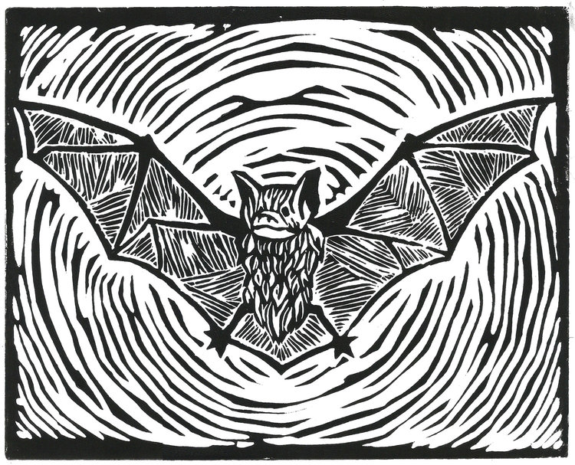
Linoleum
Linoleum printing is a form of relief printing, one of the easiest and most direct of all the printmaking methods. Linocuts can be simplistic and graphic, or as intricately detailed as you want. It's a subtractive process, meaning you cut away, or subtract, the areas you do not want to print.
Eric Devlin

Slide 4
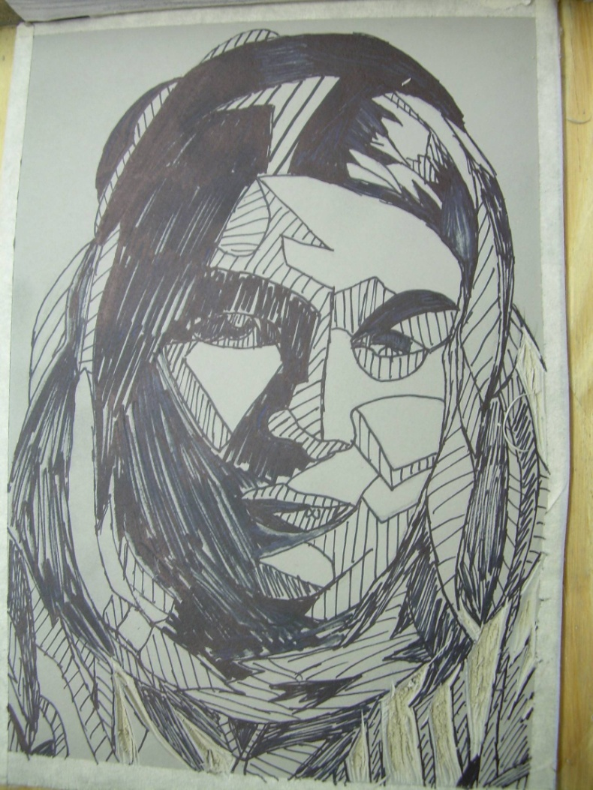
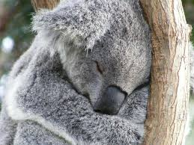
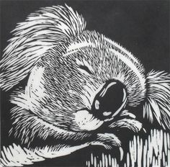
Linoleum Demo with Mrs. E
Simplified Images
Light /White = grey linoleum
Medium / Grey = Use of lines / pattern
Dark / Black = shaded in / black

Slide 5
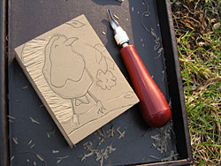
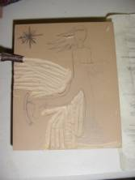
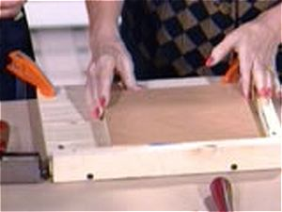
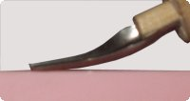
Linoleum Carving Demo

Slide 6
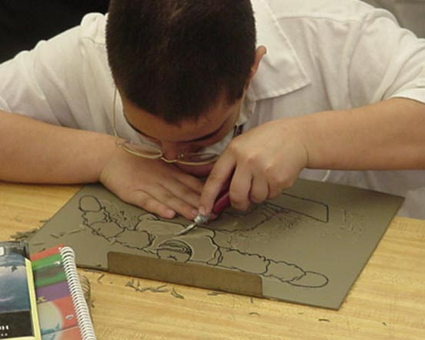
Materials:
Linoleum
Stop block
Carving tool
Linoleum Printing
Always use the bench hook/stop block
Carve away from your free hand
Turn the linoleum, not yourself.
Carve white (the grey linoleum) areas (this is the negative space and will appear as white areas or lines in your final print )
DO NOT CUT THE BLACK
AREAS ( this is positive)
Criteria:
I can carve the negative space to create an image for a linoleum print.

Slide 7
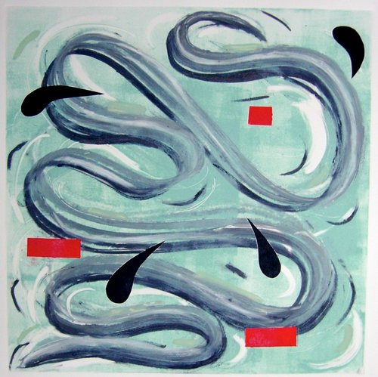
Monoprint
A monoprint is a single impression of an image made from a re-printable block. Materials such as metal plates, plexiglass, or Gelli plates. Rather than printing multiple copies of a single image, only one impression may be produced, however ghost images may also be printed depending on media.
MARY ANN STRANDELL

Slide 8
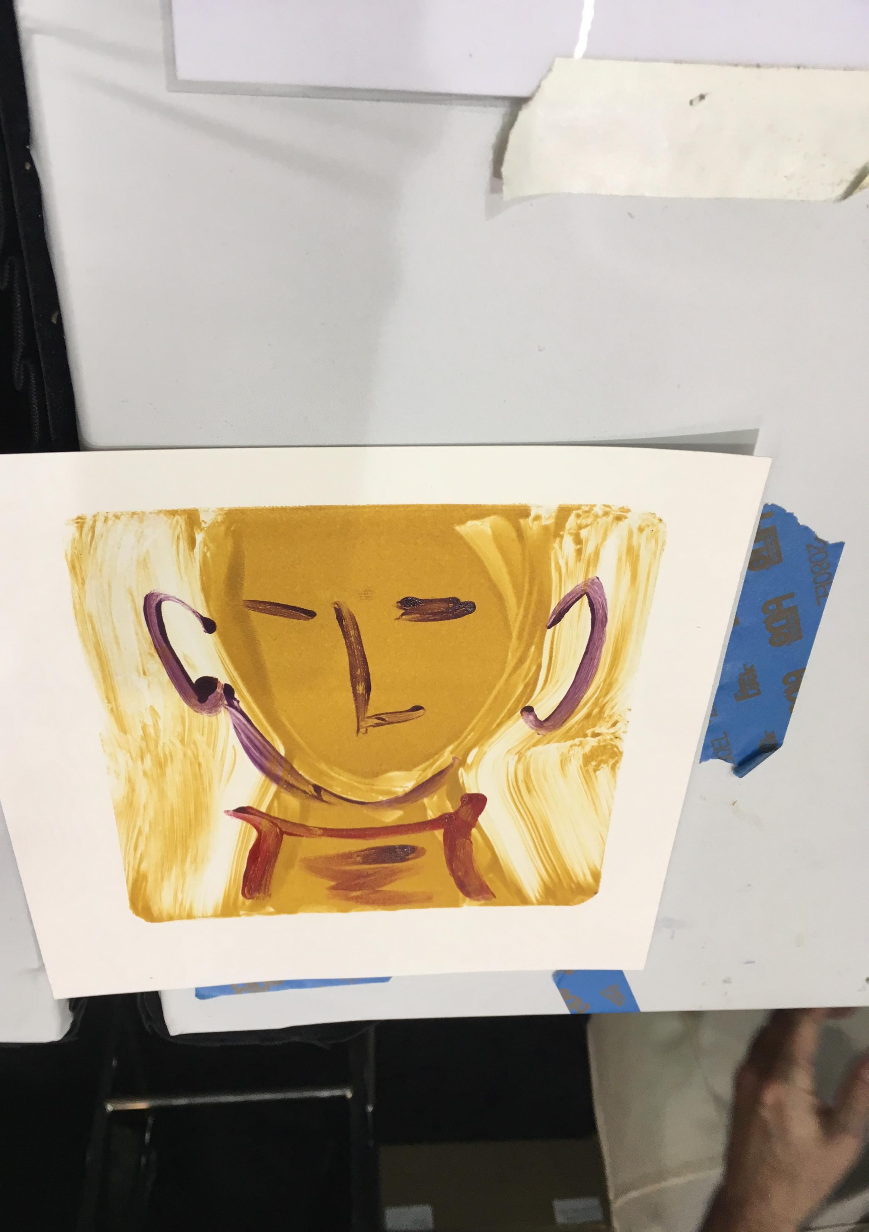
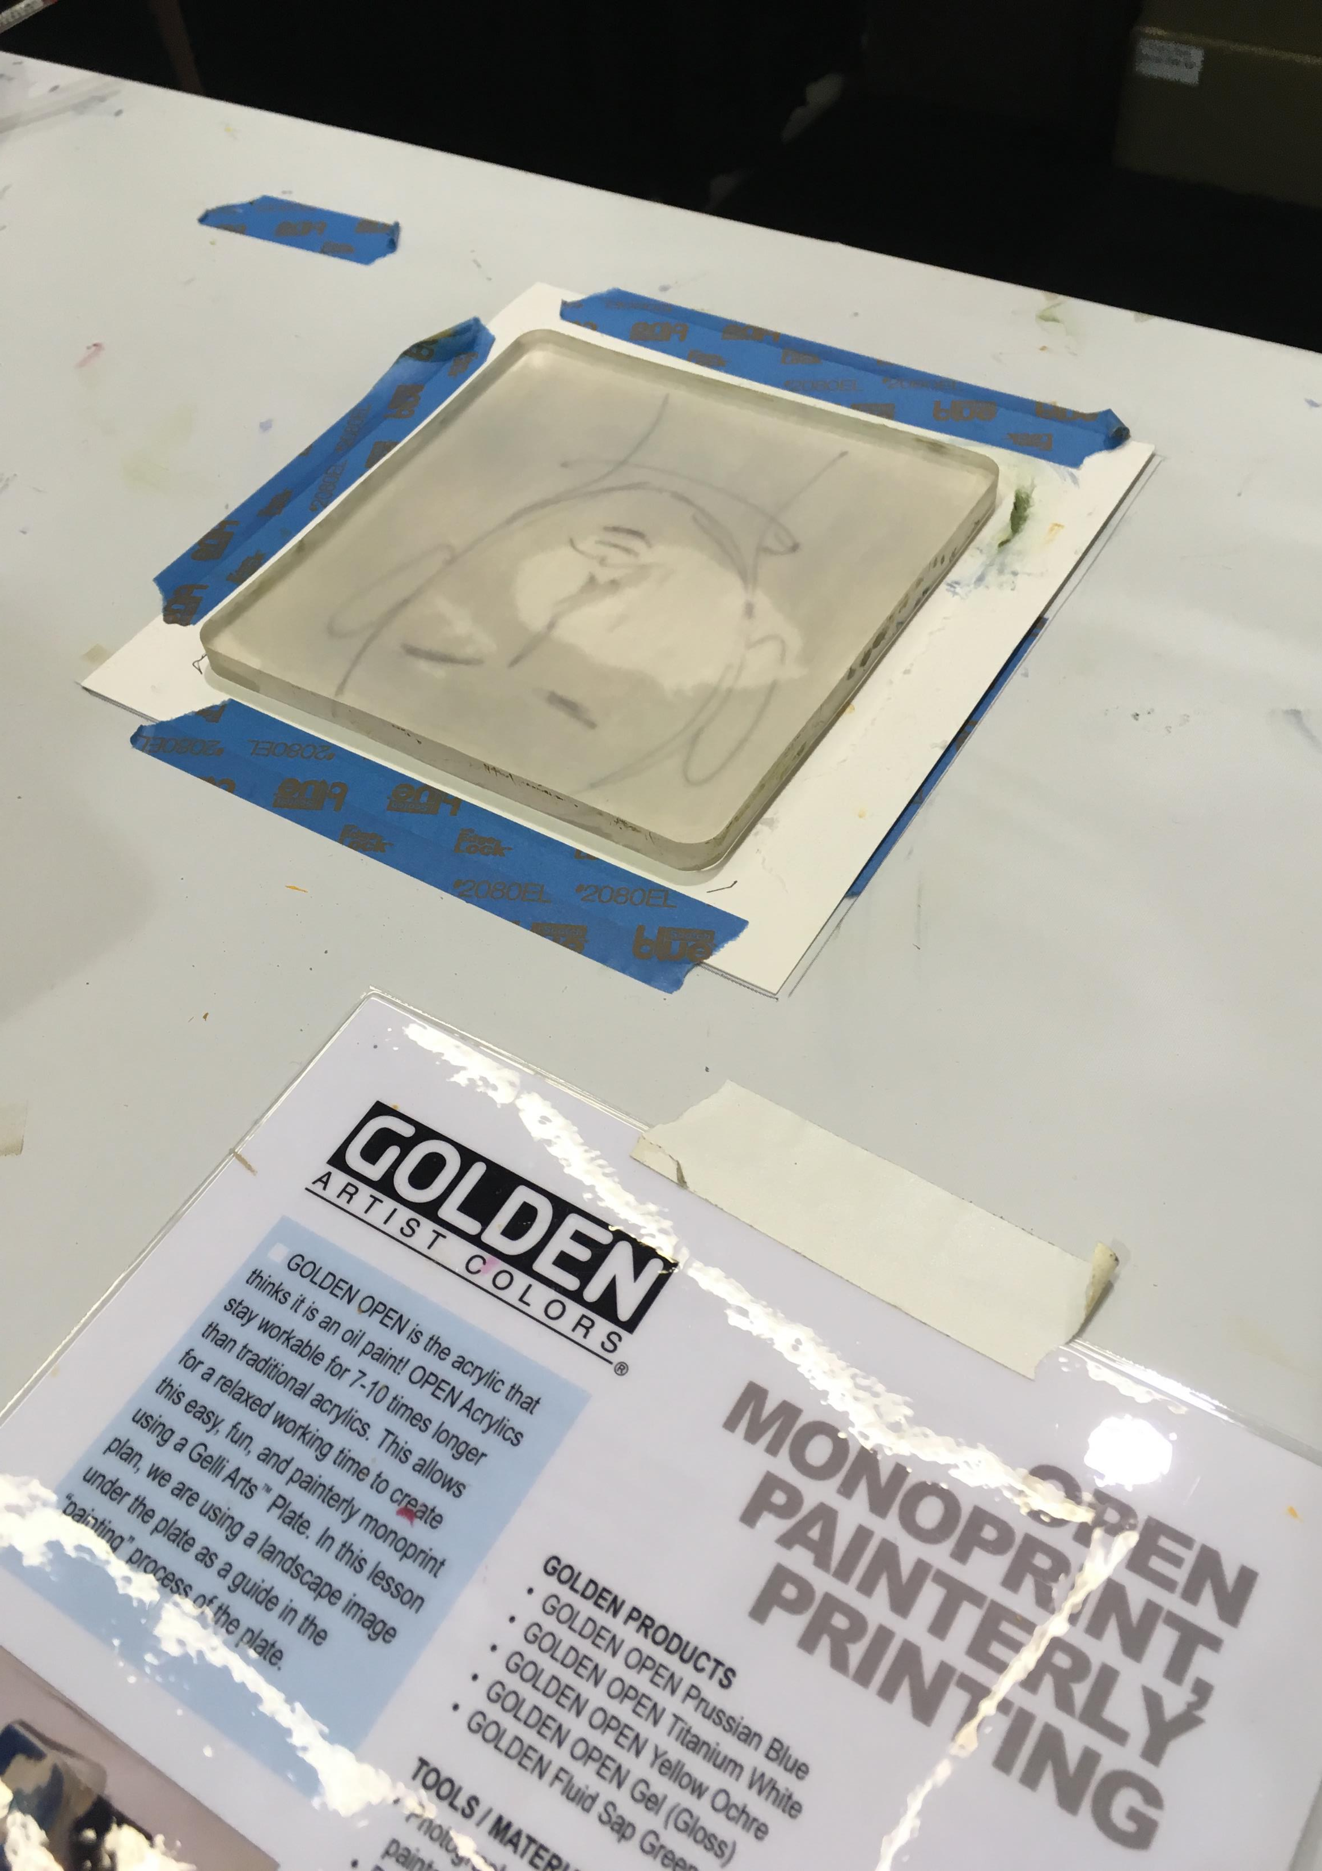
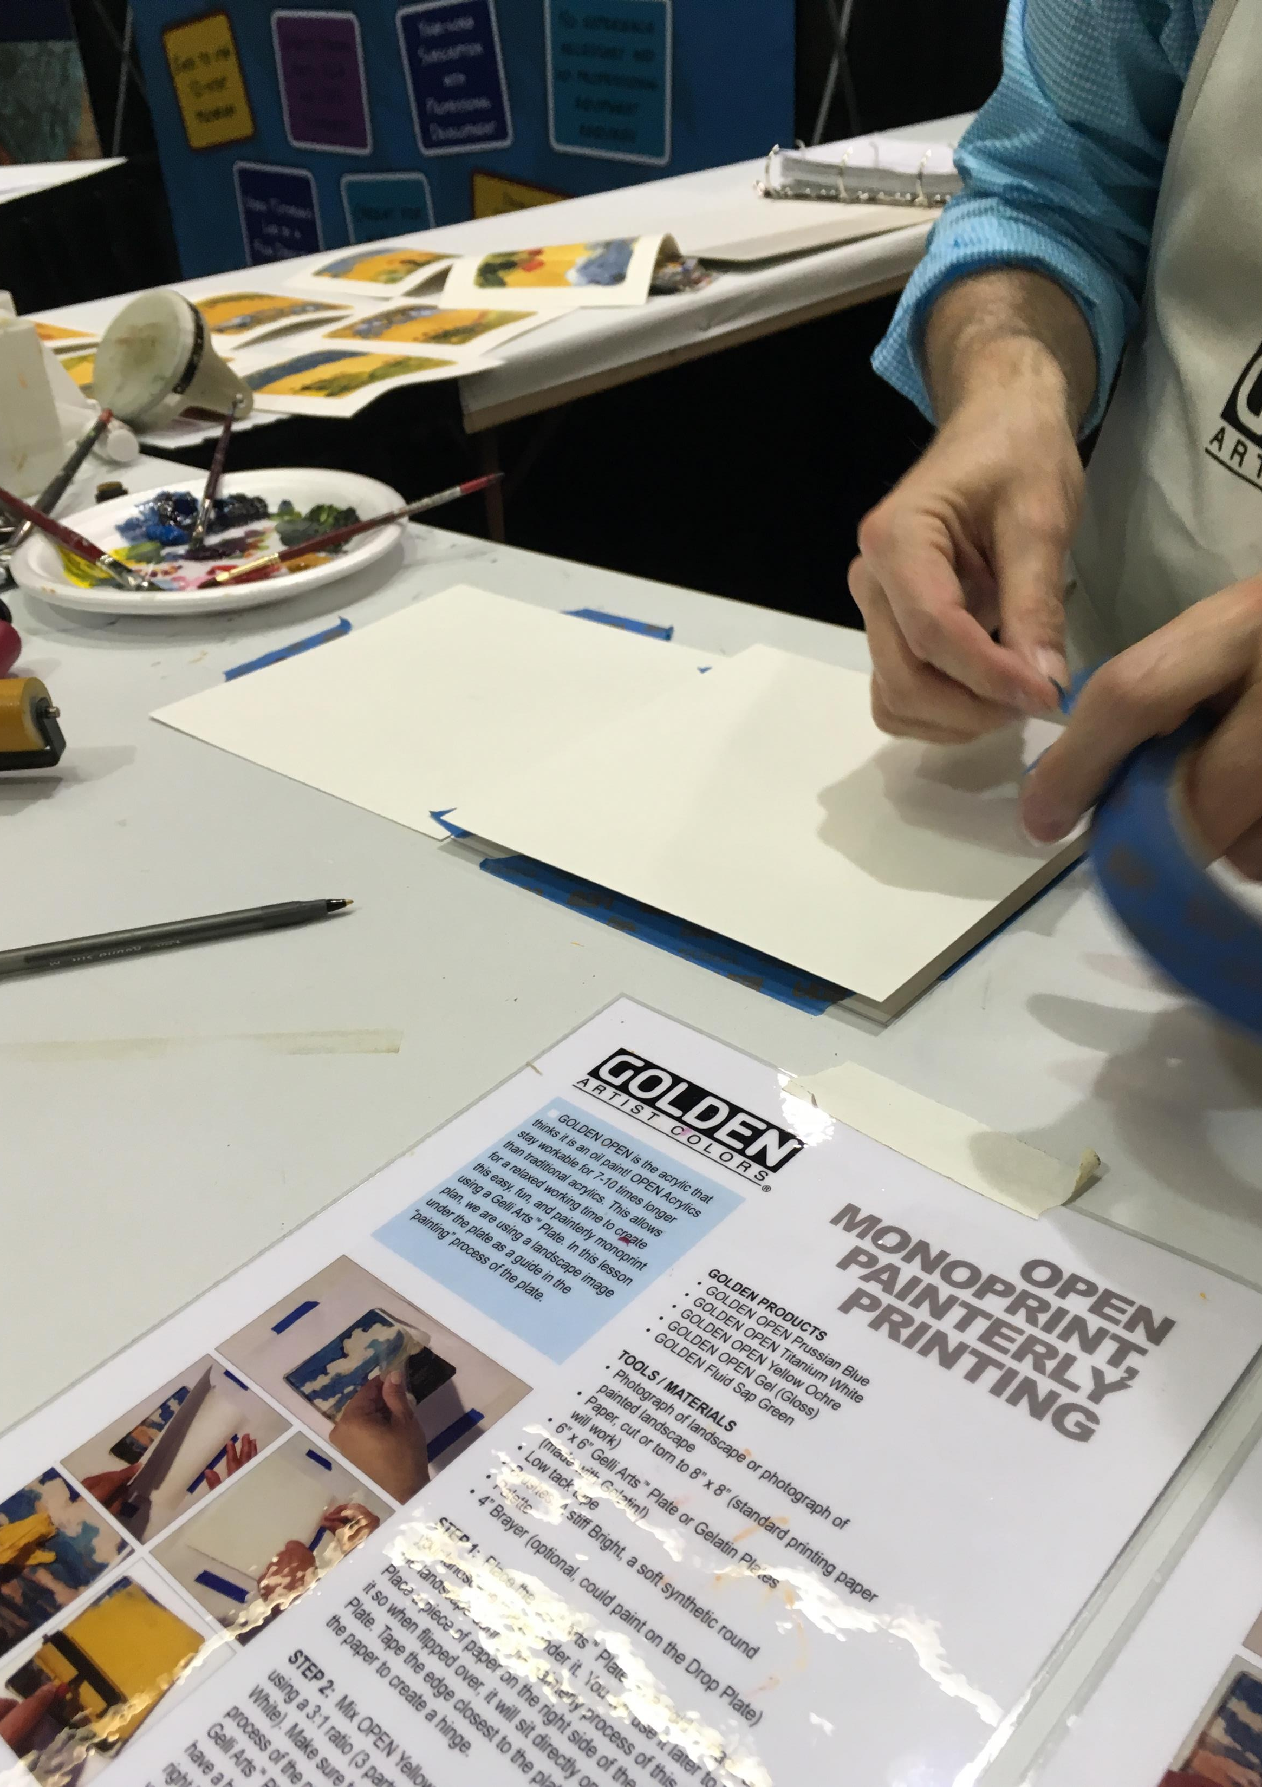
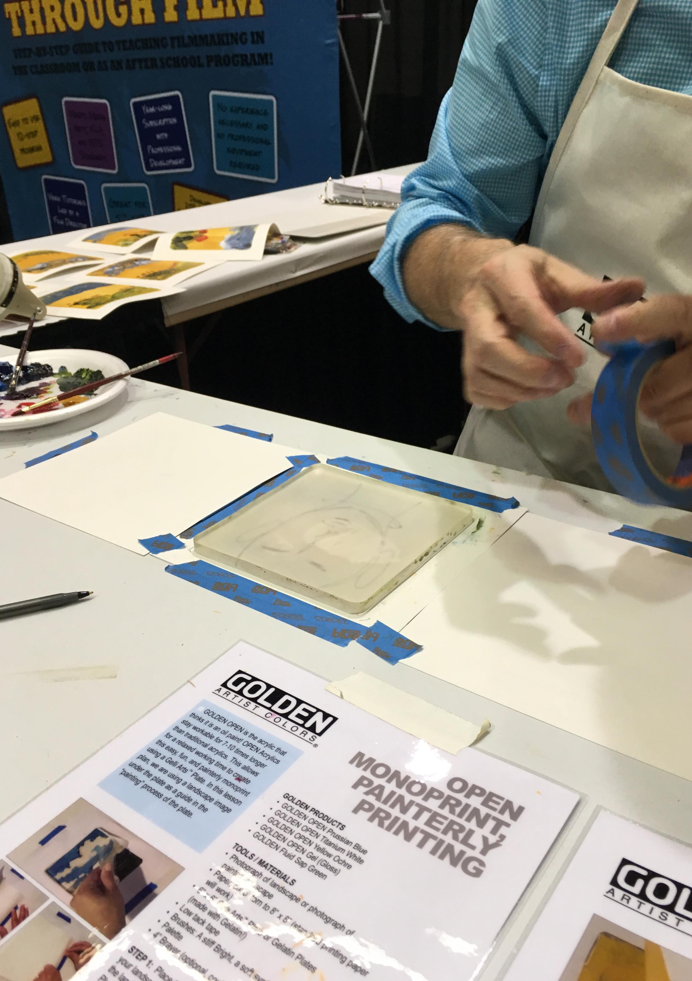
Prepping for a Monoprint (Gelli Plate)
Photo credit: Pam Ehrenreich at Golden booth NAEA 2018
Place line drawing under plate if desired, can also be combined with stencils Tape paper on either side of plate

Slide 9
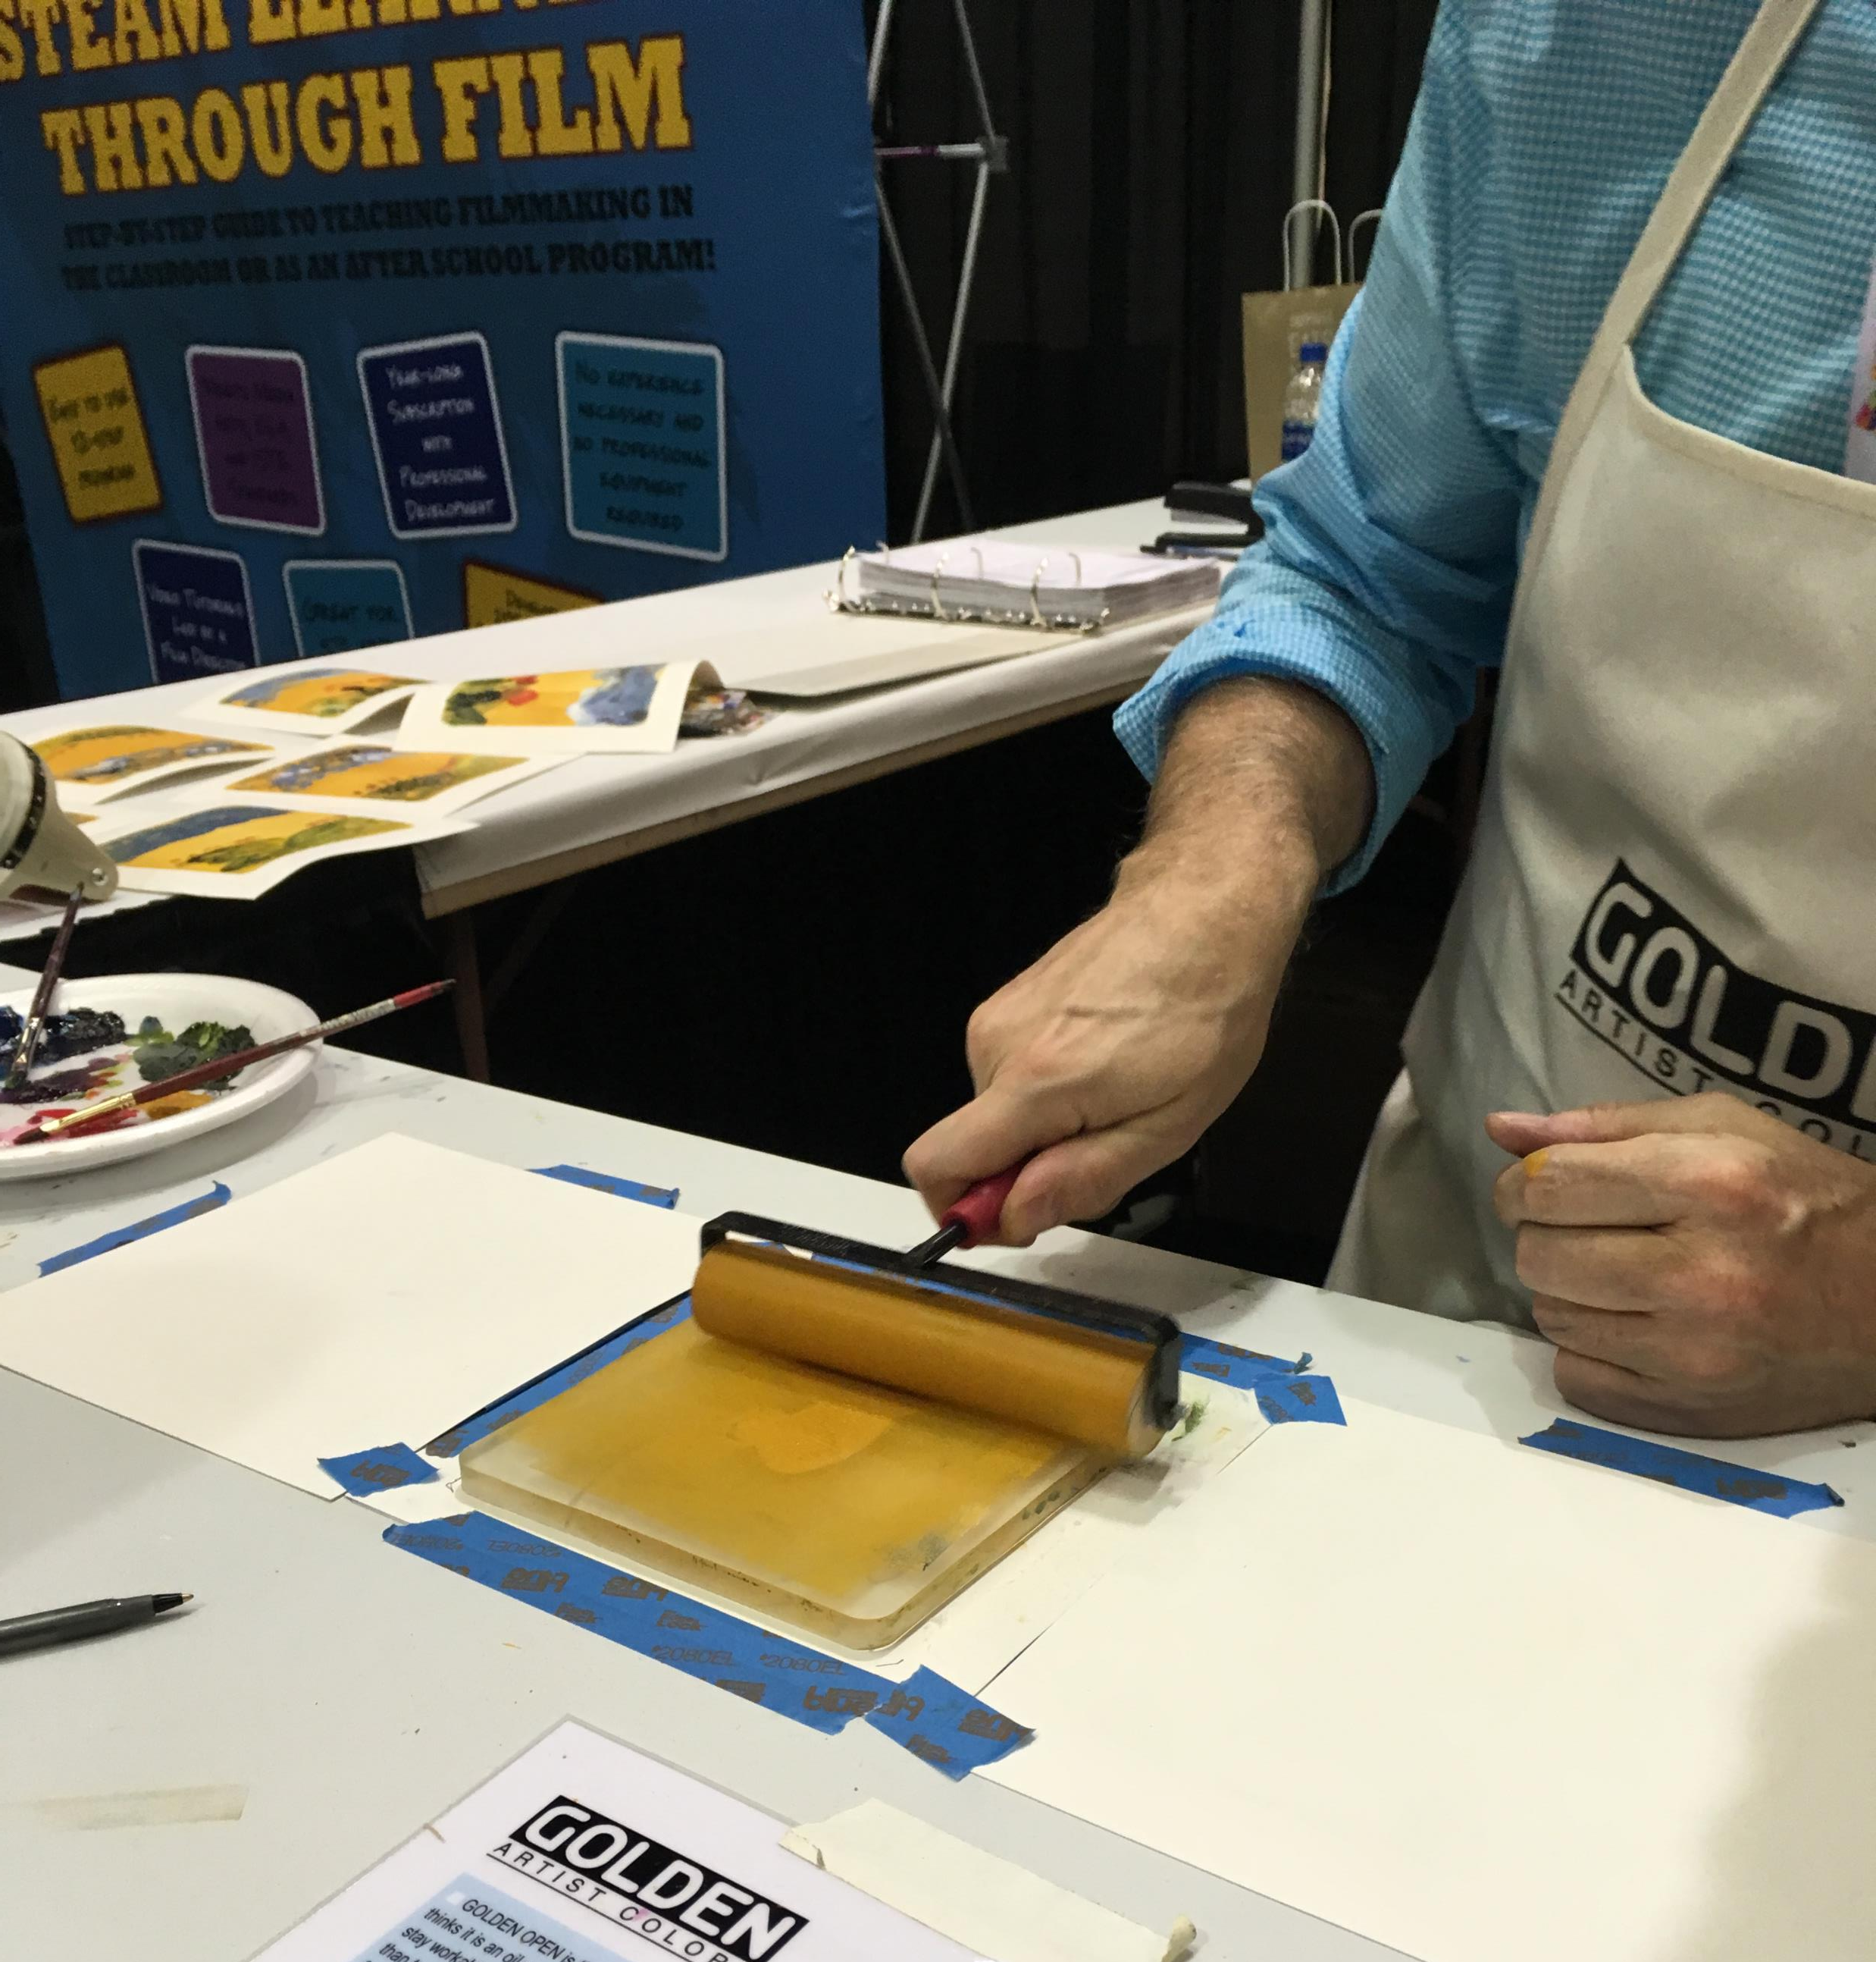
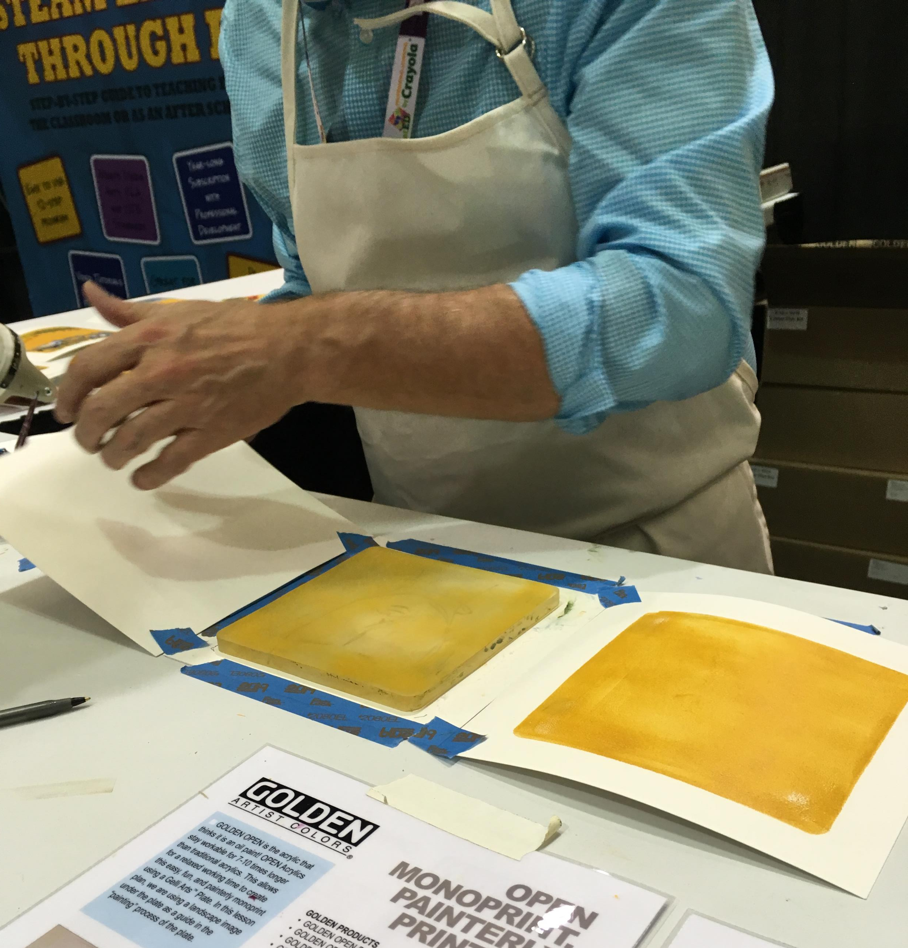
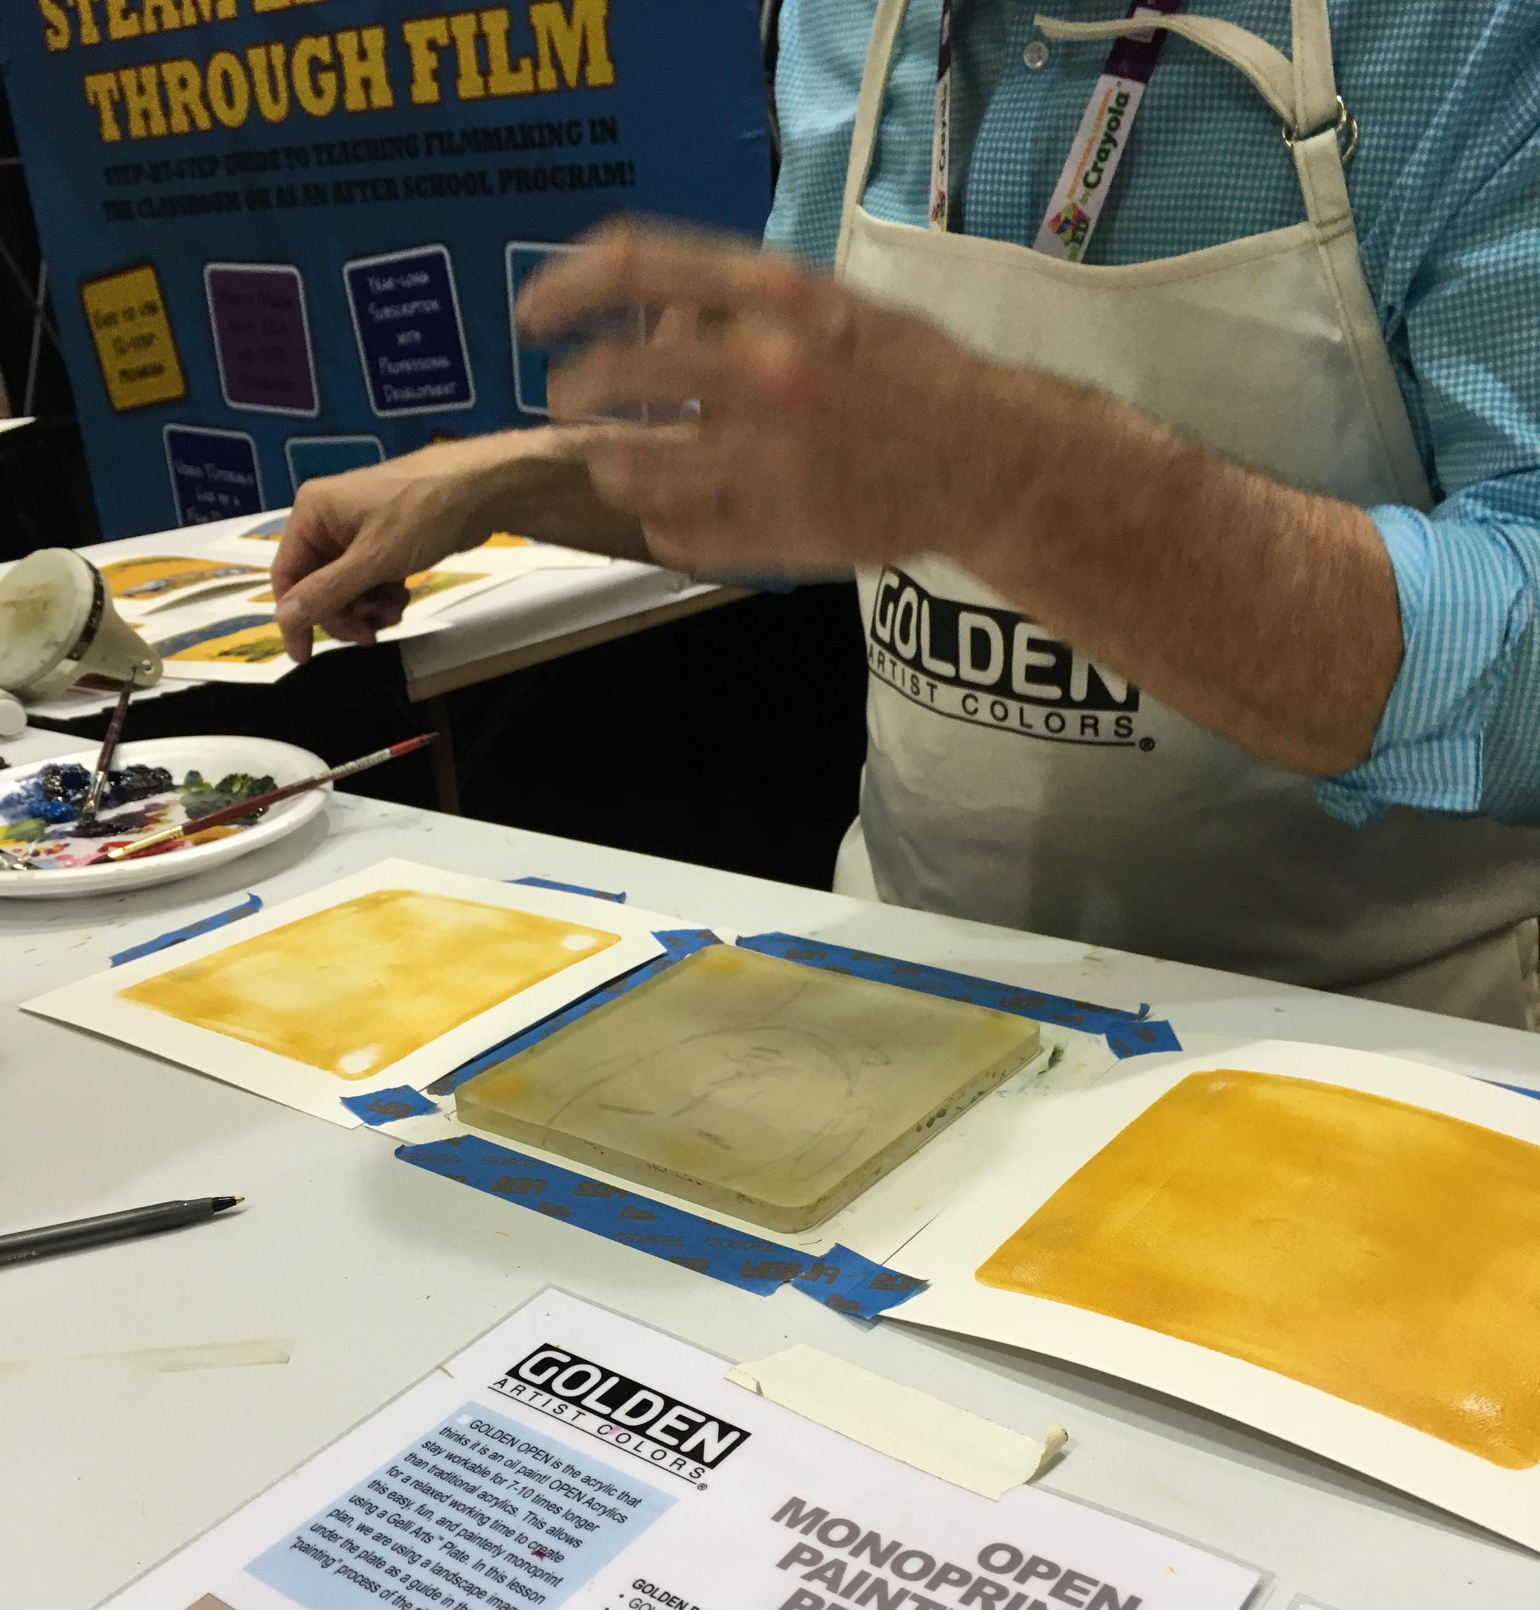
Creating a Monoprint (Gelli Plate) Layer 1
Photo credit: Pam Ehrenreich at Golden booth NAEA 2018
Place paint on plate and fold paper over one at a time, rubbing the back of each paper.

Slide 10
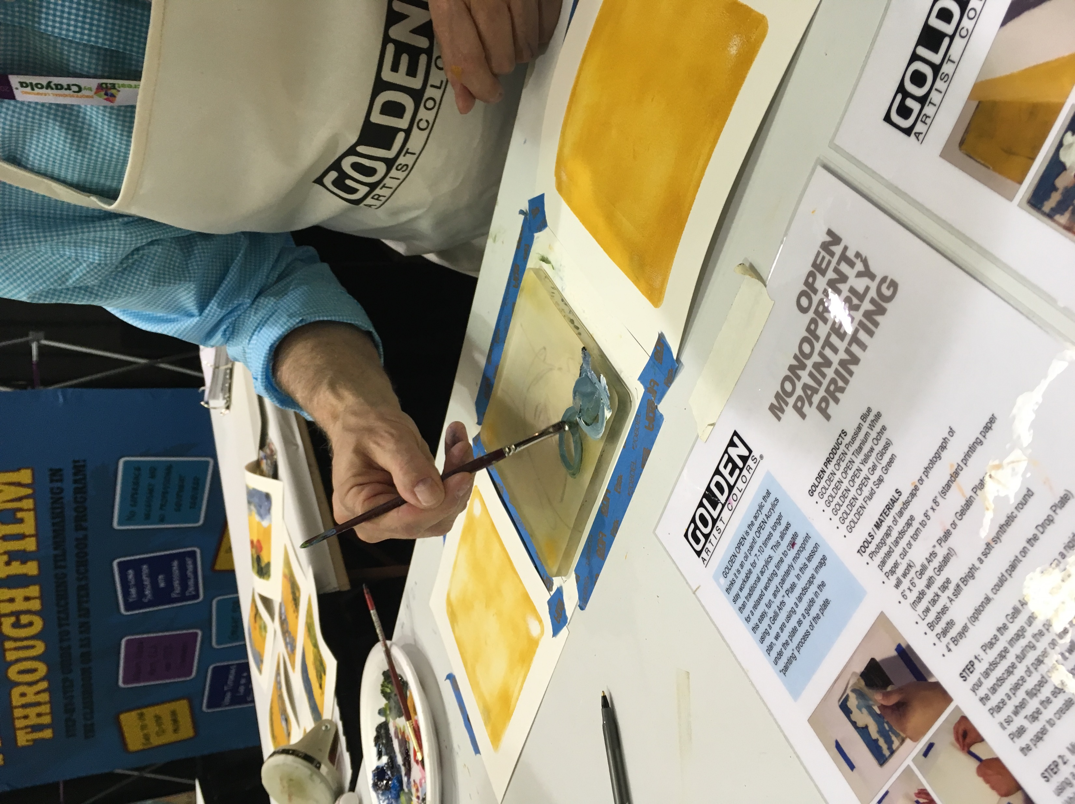
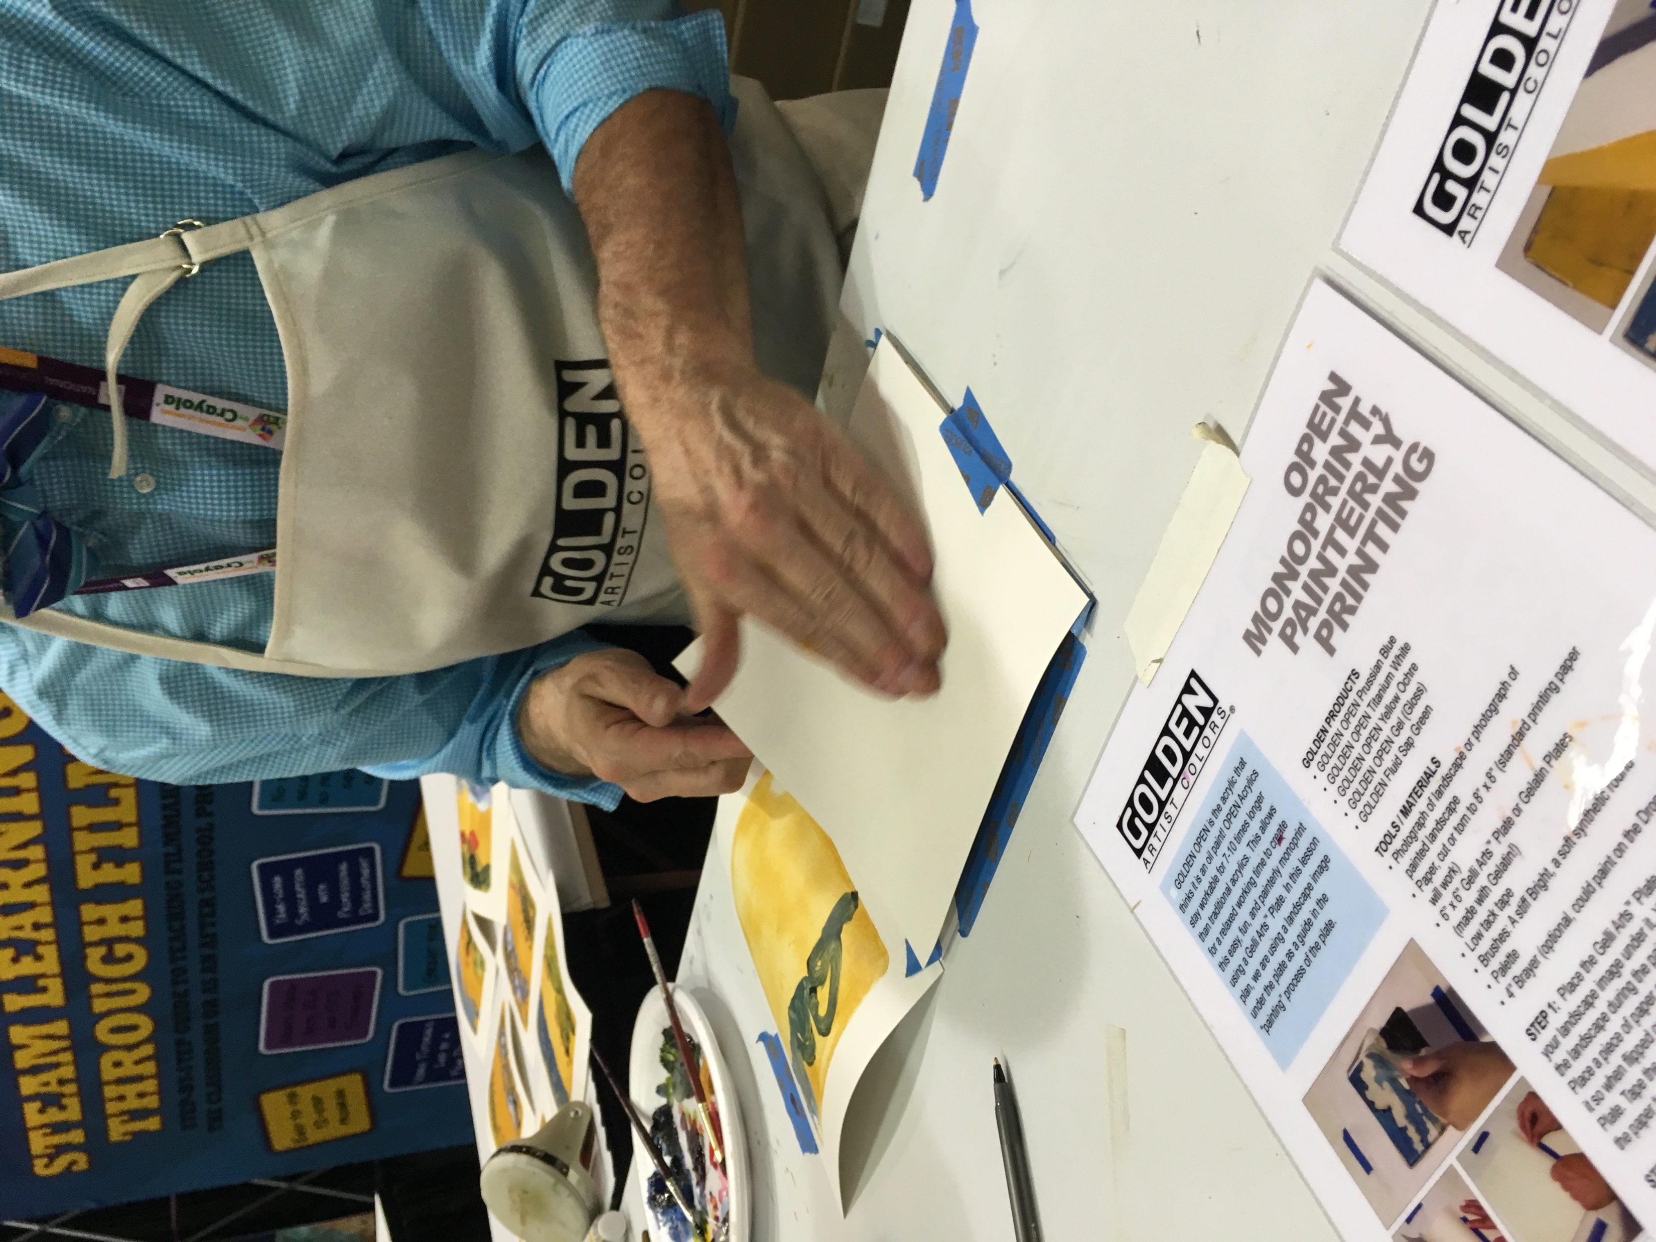
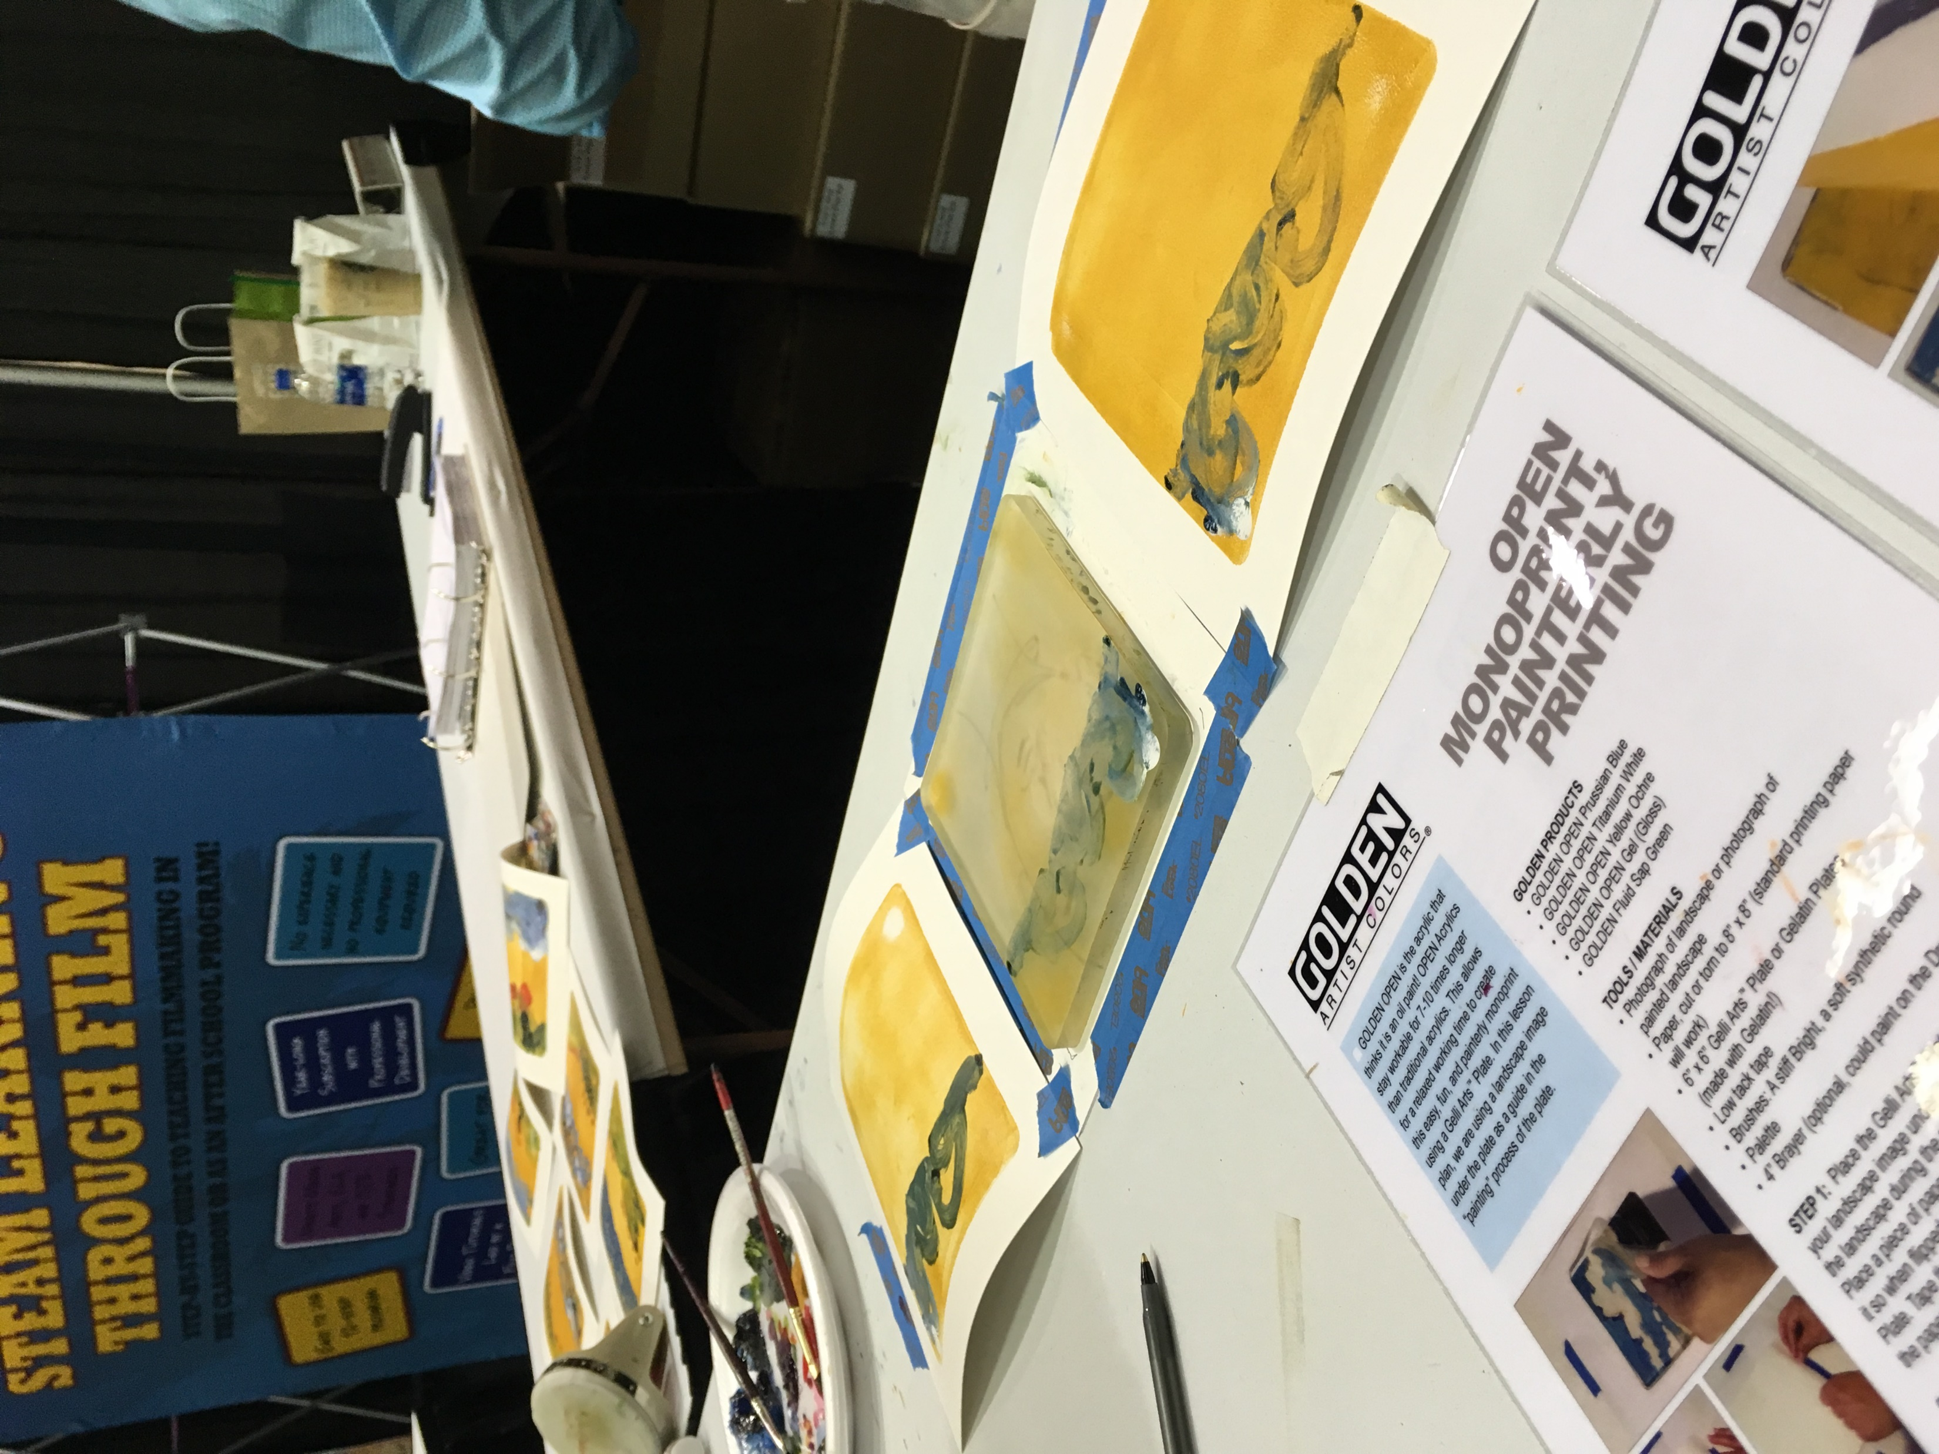
Creating a Monoprint (Gelli Plate) Layers, Layers, Layers!
Photo credit: Pam Ehrenreich at Golden booth NAEA 2018
Place paint on plate and fold paper over one at a time, rubbing the back of each paper, repeat as needed to achieve desired effects / image.

Slide 11
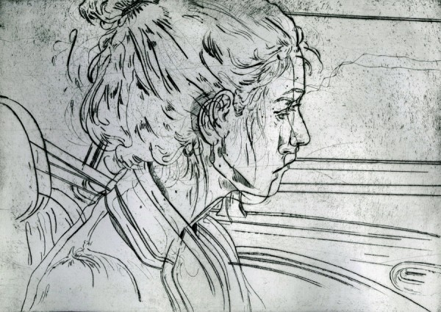
Drypoint
Drypoint is a printmaking technique of the intaglio family, in which an image is incised into a plate with a hard-pointed "needle" of sharp metal or diamond point. In principle the method is practically identical to engraving.
Angie Hoffmeister

Slide 12
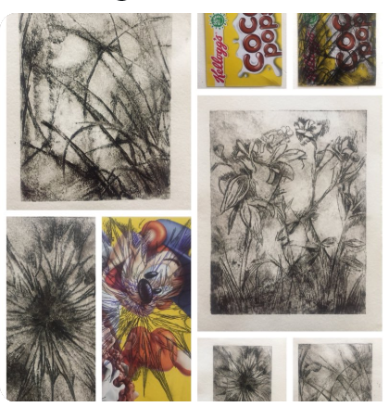
How to create a dry point print
Use a nail to carve your image or design on the printed side of a cereal type box
Rub ink or paint over the image
Wipe off excess
Place ink side down on damp paper
Burnish the back
Carefully lift plate
Louise Clazey via twitter https://twitter.com/LouiseClazey/status/1002644188373159936

